Slide 1
About the Course
The long 20th century will in all likelihood be seen in the future as the watershed in human experience:
Nine aspects:
History was primarily economic—and for the first time…
Explosion of wealth: 2%+ per year…
Cornucopia of technology…
Demographic transition…
Feminist revolution…
Empowered tyrannies…
Wealth gulfs…
Inclusion and hierarchy attenuation…
Mismanagement and insecurity…
Humanity is unlikely to see as transformative—for good and ill, but mostly for good, I think—a century again…

Slide 2
U.C. Berkeley: Economics 115: Spring 2020
20th Century Economic History: Lecture 6: Macroeconomic for Beginners/Roaring Twenties/Understanding the Great Depression
Brad DeLong
Department of Economics and Blum Center, U.C. Berkeley; and WCEG
delong@econ.berkeley.edu
last revised: 2020-02-12
for delivery: W 2020-02-12 17:00 HMMB390
<https://bcourses.berkeley.edu/courses/1487684>
<https://github.com/braddelong/public-files/blob/master/econ-115-lecture-6.pptx >

Slide 3
Preview
Chapters 9 & 10: Roaring Twenties and Great Depression
Preview
Administration
Macro for Beginners
Review: The View from 3000
The Roaring Twenties and “One Big Wave”
The Perfect Storm of 1929-1933
Takeaways
Preview of Next Time

Slide 4
Econ 115: Administration: Office Hours &c.
DeLong: Office Hours
M 11:10-12:40, Blum Hall 200B
T 11:15-12:00, Blum Hall 200B
By appointment in Blum Hall 200B, Evans 691A, or elsewhere: email <delong@econ.berkeley.edu> Sign up at: <https://www.icloud.com/numbers/0leoOOlezWp6BYKSiPJhdXy7Q>
Paper NOT due Feb 23: The Coming of Modern Economic Growth: Assignment 4: Everyone Gets 4s…
What do you think are the most important differences between the era of modern economic growth—in those economies and those periods which have been profoundly shaped by it—and earlier economies, or economies which have by-and-large not been profoundly shaped by the modern economic growth process?
Explain why you hold the views that you do. Justify your opinions with quotations from and citations to DeLong's book draft—and to other sources you believe apposite.
Write 400-500 words, and submit them on this webpage.: <https://bcourses.berkeley.edu/courses/1487684/assignments/8051997>
Dasgupta, Eichengreen, and Skidelsky will be on the exam!
Memo: bCourses website <https://bcourses.berkeley.edu/courses/1487684>

Slide 5
DeLong Office Hours
M 11:10-12:40, Blum Hall 200B
T 11:15-12:00, Blum Hall 200B
By appointment in Blum Hall 200B, Evans 691A, or elsewhere:
email <delong@econ.berkeley.edu>
Sign up at: <https://www.icloud.com/numbers/0leoOOlezWp6BYKSiPJhdXy7Q>

Slide 6
Midterm!
M Feb 24: 17:00-18:30, HMMB 390
60% short answers about concepts so far
40% an essay
INSTRUCTOR REALITY CHECK…

Slide 7
Macroeconomics for Beginners…
The Polanyian Perplex:
Start with the Polanyian Perplex: land, labor, and finance are not “commodities”; “commodities” are properly pushed to their most valuable use by market forces, and it is right and proper that each use of them must pass a profitability test…
Fictitious commodities:
“Land”—what your community is
“Labor”—what your lifestyle is
“Finance”—whether you have a job, or a firm to work for, or can quickly find another one
People think they have rights to stable communities, expected incomes, secure jobs—but in a market society the only rights that count are property rights

Slide 8
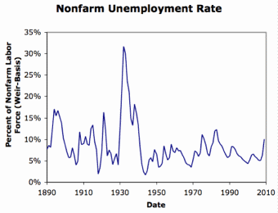
The Polanyian Perplex II
You can argue—and people do—that those who complain about “land” and “labor” becoming commodities have no legitimate beef
We have a dynamic society: things change:
Changing communities driven by (well-functioning) markets are positive-sum
Changing occupational rewards driven by (well-functioning) markets are positive-sum
The answer is social insurance and social welfare
But all this presumes full employment: there is no sense in which this much instability in firms and jobs is part of some positive-sum process

Slide 9
What’s Going on with These Huge and Long-Lasting Fluctuations in Unemployment?
A general glut—an excess supply of produced goods and services, and of labor—is an excess demand for money.
Money is something you hold as a substitute for trust
You can increase your holdings of money in two ways:
Sell more other stuff
Buy less other stuff
Different from other commodities in this way
That is the key fact here

Slide 10
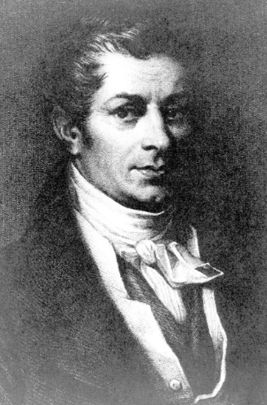
Back Up to 1803
Jean-Baptiste Say: Not possible for there to be a “general glut”:
“If certain goods remain unsold, it is because other goods are not produced; and that it is production alone which opens markets to produce.... Whenever there is a glut, a superabundance, [an excess supply] of several sorts of merchandize, it is because other articles [in excess demand] are not produced in sufficient quantities…”

Slide 11
Back Up to 1803
Thomas Robert Malthus: Then what’s going on?:
“We hear of glutted markets, falling prices, and cotton goods selling at Kamschatka lower than the costs of production.
“It may be said, perhaps, that the cotton trade happens to be glutted; and it is a tenet of the new doctrine on profits and demand, that if one trade be overstocked with capital, it is a certain sign that some other trade is understocked.
“But where, I would ask, is there any considerable trade that is confessedly under-stocked, and where high profits have been long pleading in vain for additional capital? The [Napoleonic] war has now been at an end above four years; and though the removal of capital generally occasions some partial loss, yet it is seldom long in taking place, if it be tempted to remove by great demand and high profits…”

Slide 12
By 1830 Say Had Abandoned Say’s Law
Jean-Baptiste Say:
“The Bank [of England]... forced the return of its banknotes, and ceased to put new notes into circulation…. Commerce found itself deprived at a stroke of the advances on which it had counted, be it to create new businesses, or to give a lease of life to the old. As the bills that businessmen had discounted came to maturity, they were obliged to meet them…. They sold goods for half what they had cost. Business assets could not be sold at any price. As every type of merchandise had sunk below its costs of production, a multitude of workers were without work. Many bankruptcies were declared among merchants and among bankers…”
Yet the garbage economics continues. A mystery…

Slide 13


Yoga Lessons and Lattes
Consider an economy in which only two things are produced: yoga lessons and lattes
(This is what economists do: stripped-down thought experiments that we hope capture the essence, and then generalize)
Excess demand for yoga lessons is deficient demand for lattes
Yoga teachers are overworked
Latte-pullers stand idle
Latte-pullers retrain to teach yoga
System rebalances at a higher level of human satisfaction
Not a process we want to interfere with…

Slide 14

Yoga Lessons, Lattes, and Cash
Deficient demand for yoga lessons and lattes is excess demand for cash
Yoga teachers stand idle
Latte-pullers stand idle
Can’t retrain to produce cash
In normal times bankers can produce cash
But what if times are not normal?
In normal times governments can produce cash?
But Greece…

Slide 15
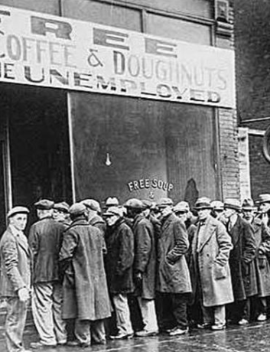
Options in a Depression
Wait it out—until something changes, and people are happy with the cash they have and so resume spending at a “normal” pace
Have those who can make “cash” do so—without cracking trust in them
Have those who can spend—usually government—ramp up their own spending
Cut wages and prices?
But the shortage of and demand for cash is often a fear that somebodies are bankrupt, and at lower wages and prices more somebodies are bankrupt

Slide 16
“General Glut” = “Excess Demand for Cash”
What determines if there is “too little” cash in an economy?
The economy as a whole is trying to accumulate cash—and so cutting (planned) spending back below (projected) income—whenever…?
Four sets of actors:
Households
Business investment committees
Foreigners
The government

Slide 17
Four Sets of Actors
Households
Have a view of their permanent income
Spend a fraction cy of the gap between their current income Y and their permanent income
C = c0 + cy x Y
Hoard in cash or save by lending to business the rest
Foreigners: sell us our imports and then decide:
to spend some on our exports, net amount NX
to hoard in cash or save by lending to businesses the rest
The government: spends G
Business investment committees: decide to borrow and invest I, depending on:
Spending E—less spending, why invest?
Their “animal spirits”
The real interest rate r they must pay to borrow

Slide 18
The Whole Model
Y—income
E—spending
E = C + I + NX + G
C = c0 + cy x Y (households)
NX (foreigners)
G (government)
I = I0 - Ir x r (businesses)
Central bank (Federal Reserve) influences (does not control) r…

Slide 19
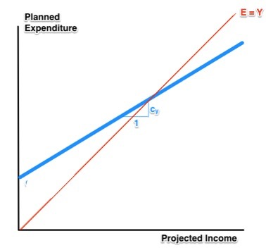
Expenditure and Income
Expenditure
E = C + I + NX + G
E = (c0+ cyY) + (I0-Irr) + NX + G
E = (c0+I0+NX+G) + cyY - Irr
Equilibrium: E = Y
What happens if planned expenditure E is less than expected income Y?
People make stuff, expecting to sell it
It doesn’t sell
So income comes in lower than people had expected
What happens next?

Slide 20
To Your i>Clickers…
Intel spends $6B to build a 14nm Fab 42 Manufacturing Facility
Definitely in GDP
Definitely not in GDP
It could go either way—there is a hole in the classification system here
Not sure

Slide 21
To Your i>Clickers…
We have our very simple toy model of the macroeconomy
Y = E (equilibrium condition); c0, I, G, NX determined by consumer confidence, by business investment committees and bank loan officers, and by foreigners; C = c0 + cy x Y, E = C + I + NX + G…
Y = μ[(c0 + I + NX) + G]
Suppose c0 + I + NX = $4T, suppose the multiplier μ is 3. Suppose G = $2T, what is GDP Y?
$18T
$12T
$6T
$9T
None of the Above

Slide 22
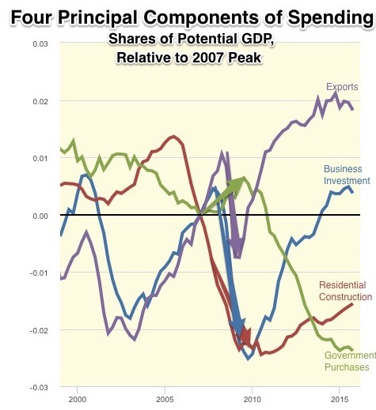
Expenditure and Income II
Y = μ(c0 + I0 + NX) - μIrr + μG
Know the multiplier
Track what happens to consumers’ expectations, business animal spirits, net exports, government purchases, and the interest rate r
And you can track the economy

Slide 23
Catch Our Breath…
Comments?
Questions?

Slide 24
Review: The View from 3000: Themes and Big Ideas
Science reaches critical mass and from it springs engineering—all of the engineering subdisciplines, including the management of human resources and of organizations. From a liberal political order spring national and then the global market economy. And from engineering and the market then, over the course of 1870-2016, spring…
History was economic…
Explosion of wealth…
Cornucopia of technology…
Demographic transition…
Feminist revolution…
Empowered tyrannies…
Wealth gulfs…
Inclusion and hierarchy attenuation…
Mismanagement and insecurity…

Slide 25

The U.S.: The Roaring Twenties
The boom of the 1920s
Mass production—the flowering of the Second Industrial Revolution
“The business of America is business”
Structural changes in the 1920s

Slide 26
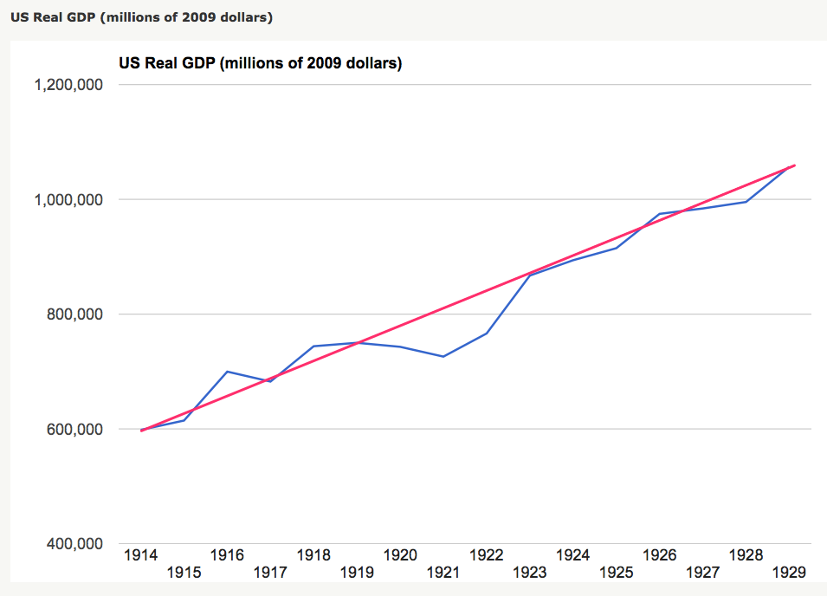
The Boom of the 1920s
The only big recession the post-WWI recession
Get rid of the inflation of WWI
Return the economy to sound finance
How big a deal was 1919-1921?
Rapid bounce-back, however

Slide 27
Structural Changes in the 1920s
Mass production—Henry Ford and the Model T
End of mass immigration—immigration restrictions of 1924
What do these do to the demand for construction, and construction workers?
The role of the stock market…
The role of the banking system…

Slide 28
Why the “Perfect Storm” of 1929-1933?
Previous Cycles:
1873—railroad
1884—railroad redux
1893—free silver
1904—Northern Securities
1907—gold drain to Britain
1914—disruption of the start of WWI
1920—deflation; return to “normalcy”
What brought previous downturns to a halt?
What made the Great Depression so great?

Slide 29
What Ended Previous Downturns?
Previous Cycles:
1873—RR investment drops to zero
1884—RR investment drops to zero
1893—confidence that gold standard will be kept
1904—Theodore Roosevelt
1907—J.P. Morgan constitutes himself a pick-up central bank
1914—profits from European war demand WWI
1920—Federal Reserve reverses course

Slide 30
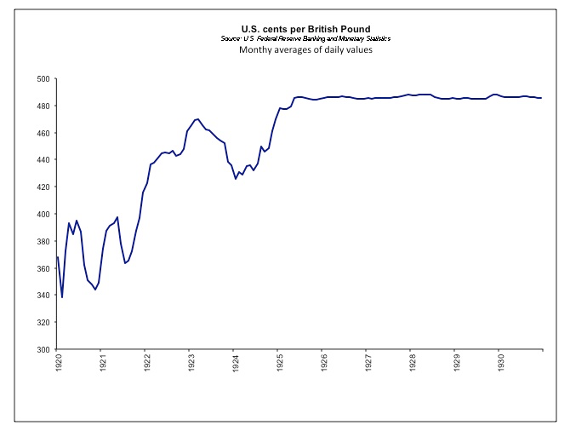
“Under the Harrow…”
Britain: restoration as job #1
What about the balance of trade?
France—inflationary boom up until 1926
Germany—hyperinflation in 1923-4
France gold acquisition policy
American gold acquisition policy

Slide 31
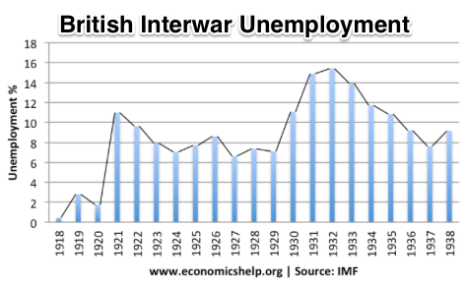
“Crying ‘Fire! Fire!’ in Noah’s Flood…”
France gold acquisition policy
American gold acquisition policy
The weakness of the gold-exchange standard—that people knew the gold standard could and would be abandoned
Labor-side pressure…
Nothing worse than an attempt to credibly commit to an incredible policy…
And then the belief that inflation was always just around the corner…

Slide 32
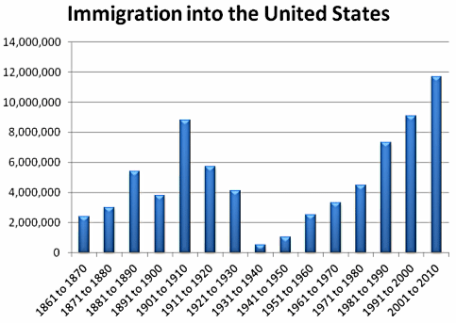
The Cutoff of Immigration
Immigration restrictions hit sharply midway through the 1920s…
Before then immigration on pace to surpass 1901-1910…
What happens when 800,000 people a year who had been arriving… suddenly stop?
What does this do to the demand for apartment buildings?
How is the market going to signal the structural adjustment that needs to take place?

Slide 33
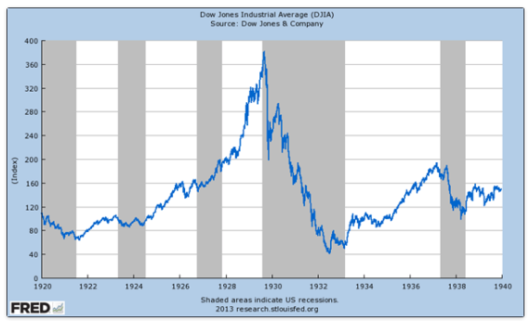
The Role of the Stock Market
Stock market doubles between the start of 1927 and late 1929
Positive-feedback margin trading
And a large number of people coming into the market who do not understand what is going on
Castles in the air
Prohibition?
Monetary policy?
Mass production?
The expectations shock produced

Slide 34
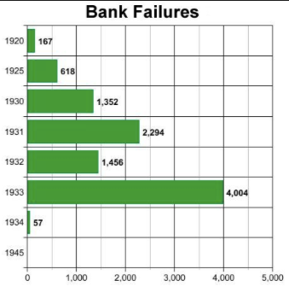
The Role of the Banking System
In the United States in the 1920s, about 600 banks failed a year—largely small rural banks
But banks set out to make riskier and riskier loans
Do they count on rescue from the Federal Reserve?
And when the Great Depression hits, bank failures rise to previously-unimaginable heights
Is there anything that could do more to boost the demand for or reduce the supply of cash?
And so call forth a general glut?
Lenders of “last resort”?

Slide 35
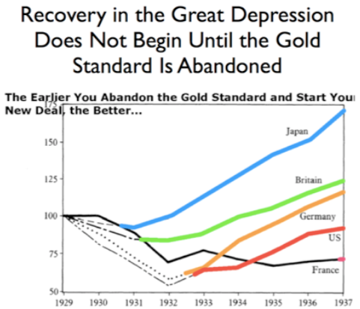
New Deals
Takahashi Korekiyo
moved early to maintain full employment
MacDonald-Snowden-Baldwin
Forced off…
Adolf Hitler
Succeeds Bruening
Franklin Delano Roosevelt
Succeeds Herbert Hoover

Slide 36
Why Was the Great Depression so Great? III
John Maynard Keynes:
“When once the recovery has been started, the manner in which it feeds on itself and cumulates is obvious. But during the downward phase, when both fixed capital and stocks of materials are for the time being redundant and working-capital is being reduced, the schedule of the marginal efficiency of capital may fall so low that it can scarcely be corrected, so as to secure a satisfactory rate of new investment, by any practicable reduction in the rate of interest.
“Thus with markets organised and influenced as they are at present, the market estimation of the marginal efficiency of capital may suffer such enormously wide fluctuations that it cannot be sufficiently offset by corresponding fluctuations in the rate of interest. Moreover, the corresponding movements in the stock-market may, as we have seen above, depress the propensity to consume just when it is most needed. In conditions of laissez-faire the avoidance of wide fluctuations in employment may, therefore, prove impossible without a far-reaching change in the psychology of investment markets such as there is no reason to expect.
“I conclude that the duty of ordering the current volume of investment cannot safely be left in private hands….”

Slide 37
Takeaways
Chapters 9 & 10: Roaring Twenties and the Great Depression
Normally an economy shifts production from sector to sector…
But what if there is a demand for more cash rather than for a different mix of goods and services?
The business cycle
The Polanyian perplex
Review: the big themes
The roaring twenties: making industrial civilization as technology and organization prepare to leap forward again…
Vulnerabilities that make the Great Depression possible…
The slide into the Great Depression…
What stopped the downslide…

Slide 38
Preview: Next Time
Depends on how far I get: try to get to “climbing out of the Great Depression”
The ebb tide of democracy
The social-insurance state
Modern democratic politics
Setting the stage for World War II

Slide 39
What Was Unconvincing Today?
Mistakes and unclarities: typos, wordos, and mindos…
In the DRAFT textbook?
In the lecture?

Slide 40
Catch Our Breath…
Ask a couple of questions?
Make a couple of comments?
Any more readings to recommend?

Slide 41
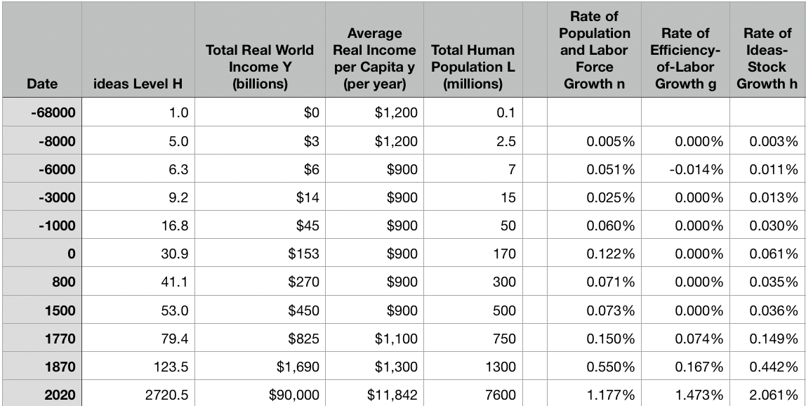
Review: The Broad Sweep
Post-1870 is the miracle:

Slide 42
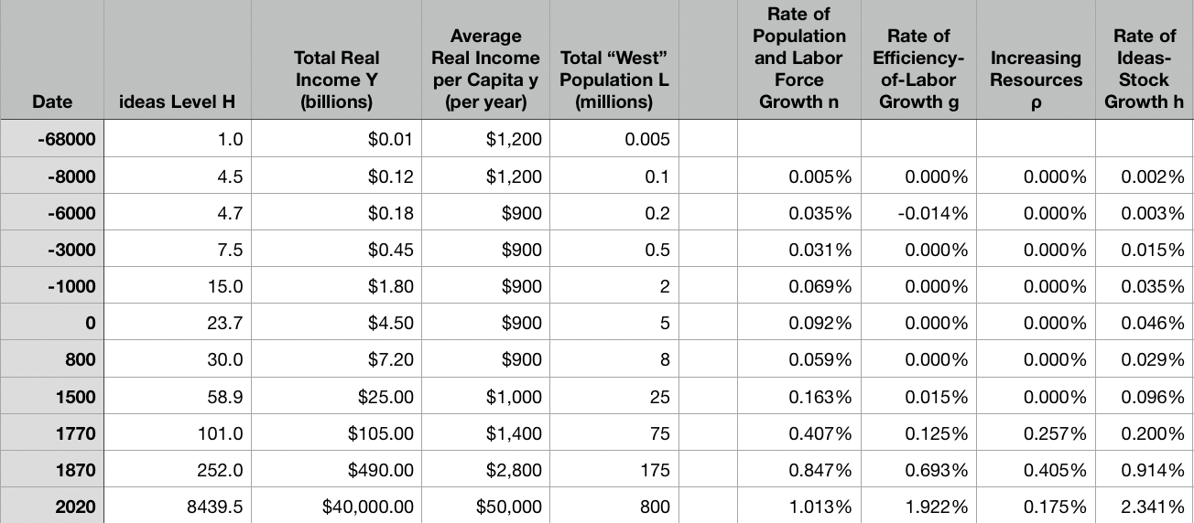
“The West”
800, 1500, 1770, or 1870?:

Slide 43
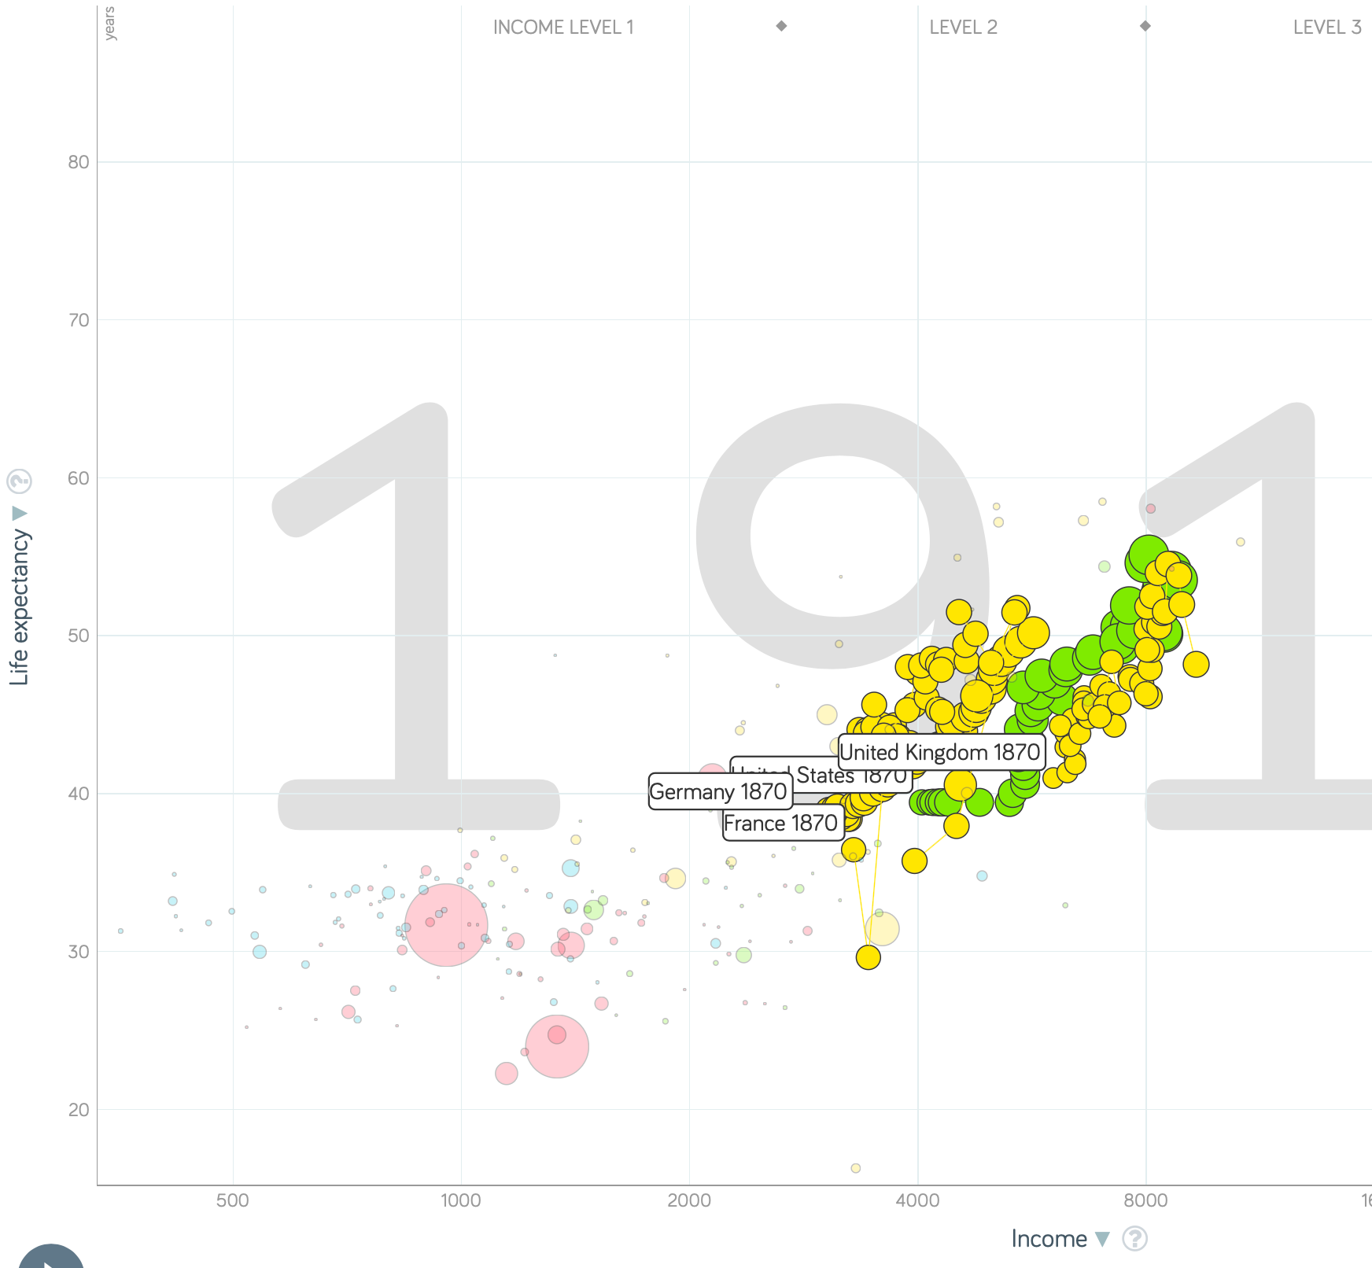
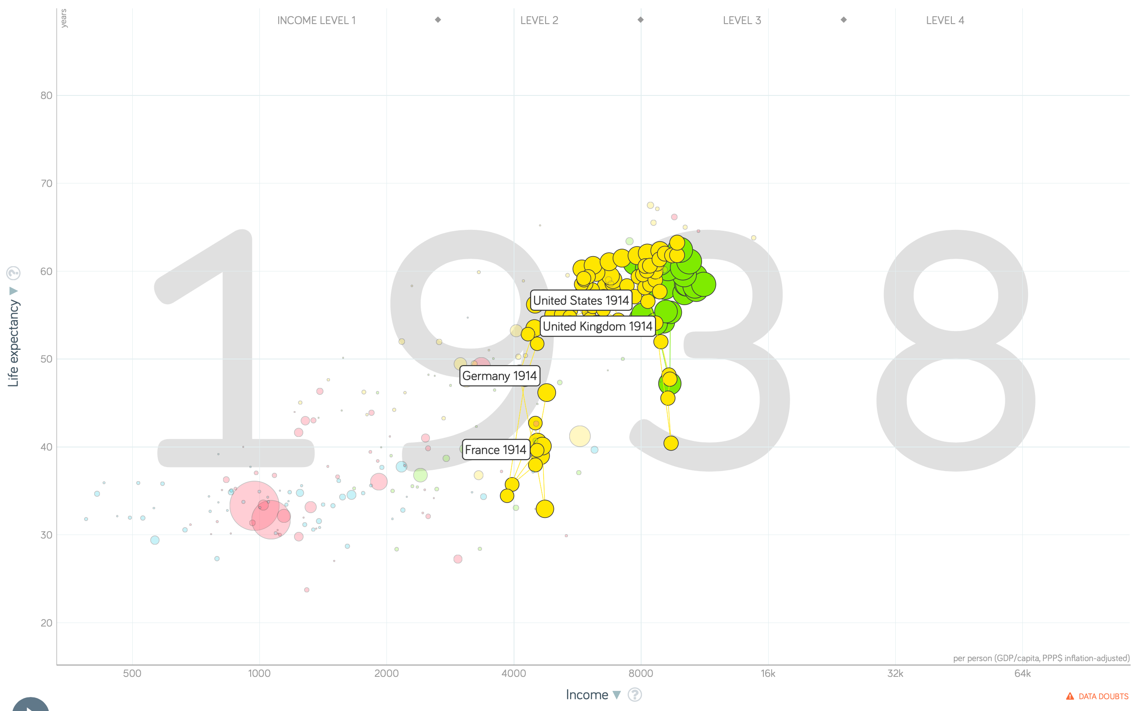
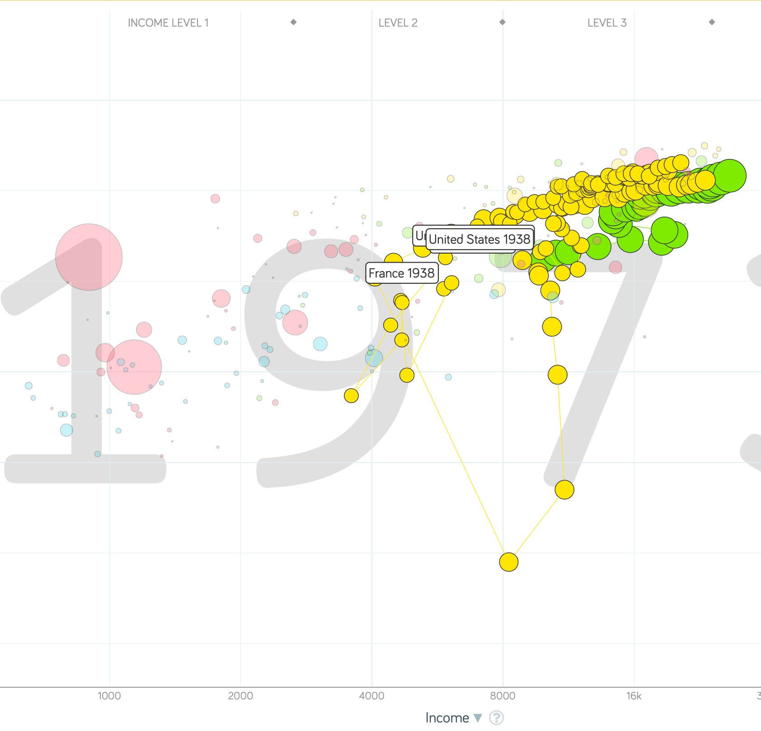
“The West”
1914-1938, 1870-1913, & 1938-1973
Rate of growth in the North Atlantic industrial core halves comparing 1870-1913 to 1914-1938; then triples afterwards over 1938-1973
Slows again after 1973

Slide 44
To Your iClickers
What was the growth rate of ideas in the industrial core of the world economy over 1870-2020?
About 2.3%/year
About 0.9%/year
About 0.23%/year
About 4%/year
None of the above

Slide 45
To Your iClickers
What was the growth rate of ideas in the industrial core of the world economy over 1770-1870?
About 2.3%/year
About 0.9%/year
About 0.23%/year
About 4%/year
None of the above

Slide 46
Review: The Belle Époque Broken
John Maynard Keynes:
“Very few of us realise[d] with conviction the intensely unusual, unstable, complicated, unreliable, temporary nature of the economic organisation by which Western Europe has lived for the last half century. We assume some of the most peculiar and temporary of our late advantages as natural, permanent, and to be depended on, and we lay our plans accordingly.
“On this sandy and false foundation we scheme for social improvement and dress our political platforms, pursue our animosities and particular ambitions, and feel ourselves with enough margin in hand to foster, not assuage, civil conflict in the European family....
“France, Germany, Italy, Austria, and Holland, Russia and Roumania and Poland, throb together, and their structure and civilisation are essentially one. They flourished together, they have rocked together in a war which we, in spite of our enormous contributions and sacrifices (like though in a less degree than America), economically stood outside, and they may fall together…”

Slide 47
Aristocracy & Social Democracy
The aristocrats had rolled the dice:
Europe in 1914 was a Europe of national populations, of industrialists and socialists, of factory workers and technicians…
Europe’s governments in 1914—especially the defense and foreign affairs ministries—had been populated by aristocrats, ex-aristocrats, and would-be aristocrats.
Landed, aristocratic, military elites had control of many of the levers of propaganda and power…
Aristocrats had had help. Industrialists and entrepreneurs were eager to provide their political support in return for economic benefits, as in the 1879 German “marriage of iron and rye”: the imposition of tariffs on imports of British steel (to protect the positions of German manufacturers) and on imports of American grain (to protect the positions of German landlords)…
On the eve of World War I, these landed military service aristocrats, ex-aristocrats, and would-be aristocrats increasingly found themselves members of a social caste that had no societal function…
But power—in the form of office and of vast (if declining relative) wealth—and propaganda—in the form of pageantry and the press—were reinforced by ideologies: Social darwinism…
The aristocrats rolled the dice—and lost…
Social democrats picked up the chips:
Expanded suffrage…
Proportional representation…
“Lands fit for heroes…”
How to provide for the benefits politicians promised?

Slide 48
Reparations, Taxes, and Inflation
Reparations
A peace “without annexations and indemnities”…
But not without reparations…
Two years’ of Germany’s national income demanded:
Much of it “boob bait for the bubbas…” on the part of Allied politicians…
But a powerful shaper of post-WWI Germany
Taxes
High and progressive tax rates…
A powerful impact on inequality…
Class war…
Inflation
U.S.: price level x1.5
Britain: price level x2.0
France: price level x7.0
French government had encouraged investment in Russian bonds…
German: price level x1,000,000,000,000
Austria, Hungary, Czechoslovakia the same…

Slide 49
Keynes’s Protest
Jan Christian Smuts:
“Poor Keynes often sits with me at night after a good dinner and we rail against the world and the coming flood. And I tell him that this is the time for Grigua’s prayer (the Lord to come himself and not to send his Son, as this is not a time for children). And then we laugh, and behind the laughter is [Herbert] Hoover’s horrible picture of thirty million people who must die unless there is some great intervention. But then again we think that things are never really as bad as that; and something will turn up, and the worst will never be. And somehow all these phases of feeling are true and right in some sense…”

Slide 50
Keynes’s Protest II
John Maynard Keynes:
“If we aim deliberately at the impoverishment of Central Europe, vengeance, I dare predict, will not limp. Nothing can then delay for long that final civil war between the forces of reaction and the despairing convulsions of revolution, before which the horrors of the late German war will fade into nothing, and which will destroy... the civilization and progress of our generation…”

Slide 51
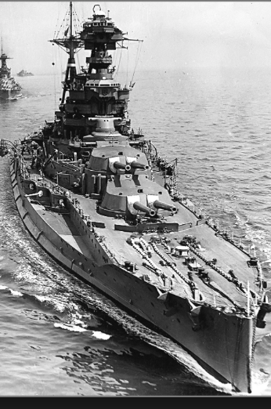
Review: World War I
Nationalism
Max Weber: “The vulgar conception of political economy is that it consists in working out recipes for making the world happy.… However… elbow-room… can [only] be won… through the hard struggle.... That standard of value adopted by a German economic theorist, can… be nothing other than a German policy and a German standard.... Our successors will... hold us responsible... for the amount of elbow-room we conquer.... The science of political economy is... a servant of... the lasting political-power interests of... our nation's power, and the vehicle of that power, the German national state…”
Erich von Manstein: von Manstein, von Lewinsky, Lewinski, Levi…
“We offered 4 battleships a year, the navy demanded 6, and we compromised at 8”

Slide 52
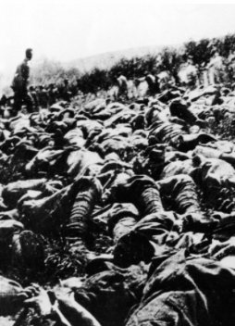
The Catastrophe of World War I: Origins
In the summer of 1914 the empires of Russia and Austria-Hungary are skirmishing diplomatically and threatening each other militarily about the latest Balkan crisis
Began when in the summer of 1914 the Archduke Franz Ferdinand and his wife Sophie were assassinated in Sarajevo
By terrorists with very close links to the intelligence service of the Kingdom of Serbia
What would Austria’s response be?
And then Germany attacks Belgium
And then Australia attacks Turkey

Slide 53
The Catastrophe of World War I: Causes
Why?: “If there is a war, let it come now…”
Russia thought it would have to fight Germany someday, and might as well while France was interested…
Austria, France, Britain (as a result of the German battle fleet) the same
“Busy giddy minds with foreign quarrels…”
A wiser man: Otto von Bismarck:
“There is nothing in the Balkans worth the bones of a single Pomeranian grenadier…”

Slide 54
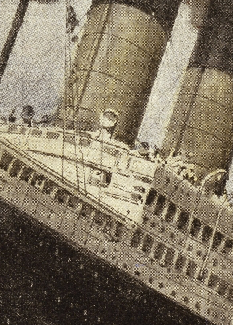
How Does the U.S. Get Involved?
British policy: binding the U.S. upper class to Britain since the 1840s
The Law of the Sea
Neutrals
Blockade
The submarine
Unrestricted submarine warfare
Zimmerman Telegram
Woodrow Wilson
“Teach the Mexicans to elect good men…”
“The war to end war…”

Slide 55
The Catastrophe of World War I: Outcome—Human
Combatants had mobilized 65M out of 100M men of military age
10M killed
10M maimed
Civilian casualties less than 10% of military
Costs of 1.5x a year’s GDP
Plus a 15M global flu epidemic
Russian, Austro-Hungarian, German, Ottoman Turkish Empires all gone…
Representative governments destabilized—or weak…
The Russian Revolution…
Hungarian, Bavarian socialist republics (short-lived)
Spartakist…
Allies demand 2 years of German GDP as “reparations”…

Slide 56
Catch Our Breath…
Comments?
Questions?

Slide 57

Review: Edward Bellamy: Looking Backward
Edward Bellamy: Looking Backward <https://delong.typepad.com/files/bellamy-backward.pdf>: Perhaps the third best-selling novel of the 19th century in the United States
2000 is a utopia…
The narrator is carried forward in time from 1887-2000 by an implausible plot device:
‘“This is the tenth day of September in the year 2000, and you have slept exactly one hundred and thirteen years, three months, and eleven days…”’
He then wanders around, looking at the utopia of 2000…
The opening:
‘“How could I live without service to the world?” you ask…. The answer is that my great-grandfather had accumulated a sum of money on which his descendants had ever since…. The sum had been originally by no means large. It was, in fact, much larger now that three generations had been supported upon it in idleness, than it was at first…’

Slide 58
The Stagecoach of Society
Those who ride and this who pull:
‘Commiseration was frequently expressed by those who rode for those who had to pull the coach, especially when the vehicle came to a bad place in the road, as it was constantly doing, or to a particularly steep hill. At such times, the desperate straining of the team, their agonized leaping and plunging under the pitiless lashing of hunger, the many who fainted at the rope and were trampled in the mire, made a very distressing spectacle, which often called forth highly creditable displays of feeling on the top of the coach.
‘At such times the passengers would call down encouragingly to the toilers of the rope, exhorting them to patience, and holding out hopes of possible compensation in another world for the hardness of their lot, while others contributed to buy salves and liniments for the crippled and injured. It was agreed that it was a great pity that the coach should be so hard to pull, and there was a sense of general relief when the specially bad piece of road was gotten over. This relief was not, indeed, wholly on account of the team, for there was always some danger at these bad places of a general overturn in which all would lose their seats.
‘It must in truth be admitted that the main effect of the spectacle of the misery of the toilers at the rope was to enhance the passengers’ sense of the value of their seats upon the coach, and to cause them to hold on to them more desperately than before…

Slide 59
The Stagecoach of Society II
“Finer clay”:
‘The other fact is yet more curious, consisting in a singular hallucination which those on the top of the coach generally shared, that they were not exactly like their brothers and sisters who pulled at the rope, but of finer clay, in some way belonging to a higher order of beings who might justly expect to be drawn. This seems unaccountable, but, as I once rode on this very coach and shared that very hallucination, I ought to be believed.
‘The strangest thing about the hallucination was that those who had but just climbed up from the ground, before they had outgrown the marks of the rope upon their hands, began to fall under its influence. As for those whose parents and grand-parents before them had been so fortunate as to keep their seats on the top, the conviction they cherished of the essential difference between their sort of humanity and the common article was absolute. The effect of such a delusion in moderating fellow feeling for the sufferings of the mass of men into a distant and philosophical compassion is obvious.
‘To it I refer as the only extenuation I can offer for the indifference which, at the period I write of, marked my own attitude toward the misery of my brothers…

Slide 60
The Stagecoach of Society III
Class war:
‘The sanguine argued very forcibly that it was in the very nature of things impossible that the new hopes of the workingmen could be satisfied, simply because the world had not the wherewithal to satisfy them. It was only because the masses worked very hard and lived on short commons that the race did not starve outright, and no considerable improvement in their condition was possible while the world, as a whole, remained so poor.
‘It was not the capitalists whom the laboring men were contending with, these maintained, but the iron-bound environment of humanity, and it was merely a question of the thickness of their skulls when they would discover the fact and make up their minds to endure what they could not cure.
The less sanguine admitted all this. Of course the workingmen’s aspirations were impossible of fulfillment for natural reasons, but there were grounds to fear that they would not discover this fact until they had made a sad mess of society. They had the votes and the power to do so if they pleased, and their leaders meant they should. Some of these desponding observers went so far as to predict an impending social cataclysm. Humanity, they argued, having climbed to the top round of the ladder of civilization, was about to take a header into chaos…’

Slide 61
The Limit of Human Felicity I
In the music room:
‘She made me sit down comfortably, and, crossing the room, so far as I could see, merely touched one or two screws, and at once the room was filled with the music of a grand organ anthem; filled, not flooded, for, by some means, the volume of melody had been per- fectly graduated to the size of the apartment. I listened, scarcely breathing, to the close. Such music, so perfectly rendered, I had never expected to hear.
‘“Grand!” I cried, as the last great wave of sound broke and ebbed away into silence. “Bach must be at the keys of that organ; but where is the organ?”…
‘“There are a number of music rooms in the city, perfectly adapted acoustically to the different sorts of music. These halls are connected by telephone with all the houses of the city…. Any one of the four pieces now going on that you prefer, you can hear by merely pressing the button which will connect your house-wire with the hall where it is being rendered…”’

Slide 62
The Limit of Human Felicity III
Four live orchestras you can listen to on the speakerphone!
‘“It appears to me, Miss Leete,” I said, “that if we could have devised an arrangement for providing everybody with music in their homes, perfect in quality, unlimited in quantity, suited to every mood, and beginning and ceasing at will, we should have considered the limit of human felicity already attained, and ceased to strive for further improvements…”’

Slide 63
Review: The View from 3000: Themes & Big Ideas
Science reaches critical mass and from it springs engineering—all of the engineering subdisciplines, including the management of human resources and of organizations. From a liberal political order spring national and then the global market economy. And from engineering and the market, and the large bureaucratic corporation then, over the course of 1870-2016, spring…
History was economic…
Explosion of wealth…
Cornucopia of technology…
Demographic transition…
Feminist revolution…
Inclusion and hierarchy attenuation…
Empowered tyrannies…
Wealth gulfs…
Mismanagement and insecurity…

Slide 64
Measuring Growth
What are my estimates of the rate of growth of economically-useful human knowledge over 1-1500, 1500-1800, 1800-1870, and 1870-2000?
0.02%/year, 0.2%/year, 0.5%/year, and 0.8%/year
0.000%/year, 0.02%/year, 0.2%/year, and 0.8%/year
0.02%/year, 0.2%/year, 0.8%/year, and 2.3%/year
0.2%/year, 0.8%/year, 2.3%/year, and 4.7%/year
None of the above.

Slide 65
What Is the Key Factor in the Explosion of Wealth in the 20th Century?
Yes, many things contributed. But suppose you have to pick just one

Slide 66
What Are the Four Factors That I See as Making for the Explosion of Wealth in the 20th Century?
Yes, there are many, many more things that contributed. But suppose you have to pick just four:

Slide 67
Demography II
What is the principal cause of the demographic transition?
Female wealth and control of property.
Female literacy.
Falling infant and child mortality.
Land shortages and high unemployment.
Something else.

Slide 68
Feminism
How many pregnancies do we think Abigail Smith Adams had between when she was 20 and 34?
2.
4.
6.
8.
18.

Slide 69
Empowered Tyrannies II
How many world leaders are members of the 10-million club?
2.
4.
6.
8.
18.

Slide 70
Inclusion and Hierarchy Attenuation
At the start of the 1970s, future President Ronald Reagan said that diplomats from Tanzania appeared uncomfortable:
resisting pressure to vote with the Soviet Union at the United Nations.
making small talk with New York socialites.
wearing shoes.
in formal tuxedos.
None of the above.

Slide 71
Economic Mismanagement and Insecurity II
According to Karl Polanyi, what rights does the market economy respect?
rights to land (a stable community).
rights to labor (a “just” income).
rights to finance (a stable economic place).
rights to property (the ability to keep what you manage to claim to earn).
None of the above.

Slide 72
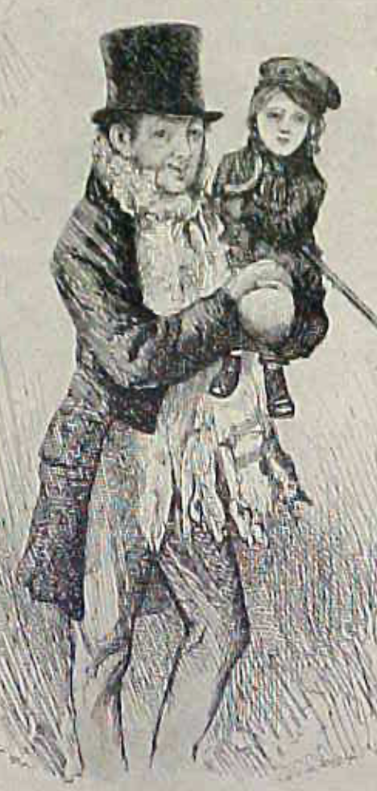
Review: The Watershed: 1870 as an Inflection Point
As of 1870, had the Industrial Revolution raised the standard of living or lightened the toil of the working class in England, the country at its center?
Yes
No
It’s not clear
Why? Malthusian forces—population explosion & thus smaller farm sizes. Growth, the growth had been slow 0.8%/year?

Slide 73
Globalization
Who called the era of globalization and growth from 1870 to 1914 an “economic El Dorado”?
Karl Marx
John Stuart Mill
Thomas Robert Malthus
John Maynard Keynes
None of the above
What would the others have said?

Slide 74
Migration
How many people of the roughly 1.5 billion then-population of the world left their continents of origin between 1870-1913?
10 million
50 million
100 million
200 million
400 million

Slide 75
Before 1870, Ideas Growth Not Fast Enough
And population growth accelerates as the world is not rich enough to undergo the demographic transition:
Value of useful and deployed ideas about technology and organization
-8000: 1
1: 3.5
1500: 4.75
1800: 9
1870: 16
2020: 421
Growth Rates:
-8000 to 1500: 0.02%/year
1500 to 1800: 0.2%/year
1800 to 1870: 0.8%/year
1870 to 2020: 2.3%/year
What caused these accelerations? What caused this last acceleration?

Slide 76
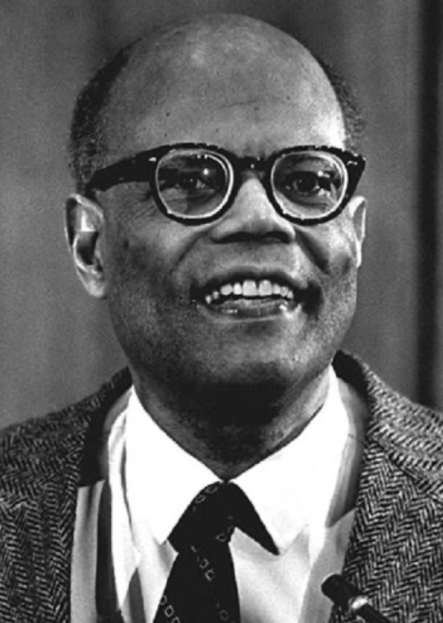
The Last Acceleration
The industrial research lab to routinize invention, and the modern corporation to routinize diffusion and deployment
Plus general purpose technologies—machine tools, non-human power sources
Arthur Lewis:
“New commodities: telephones, gramophones, typewriters, cameras, automobiles, and so on, a seemingly endless process whose latest twentieth-century additions include aeroplanes, radios, refrigerators, washing machines, television sets, and pleasure boats. Thus a rich man in 1870 did not possess anything that a rich man of 1770 had not possessed; he might have more or larger houses, more clothes, more pictures, more horses and carriages, or more furniture than say a school teacher possessed, but as likely as not his riches were displayed in the number of servants whom he employed rather than in his personal use of commodities…”
Not so much the particular technologies, as the grasping of the fact that there was a broad and deep range of new technologies to be discovered.
As much as it was new technologies, it was large-scale corporate organizations that could and did plan the division of labor to make use of and then market technologies.
And as much, it was that the global market meant that there was now a great deal of money to be made from the routinization of the exploration, development, and deployment of technological possibilities

Slide 77
Worldwide: The Broad Sweep
Post-1870 is the miracle:

Slide 78
“The West”
800, 1500, 1770, or 1870?:

Slide 79
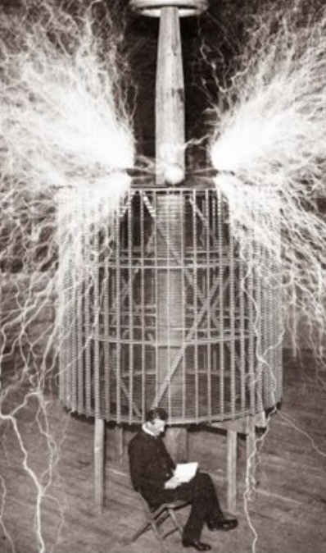
Who Is This Man?
And is he in any real danger?
Thomas Edison, and no
Andrew Carnegie, and no
Nicola Tesla, and no
Thomas Edison, and yes
Herbert Hoover, and yes

Slide 80
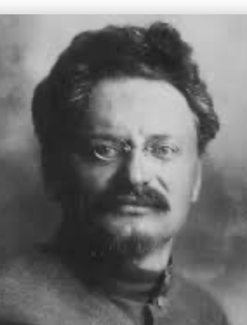
Lev Bronstein
Why did he say this?
“I had had no time to more than catch the general life-rhythm of the monster known as New York…”
“I left for Europe with the feeling of a man who has had only a peek into the furnace where the future is being forged…"

Slide 81
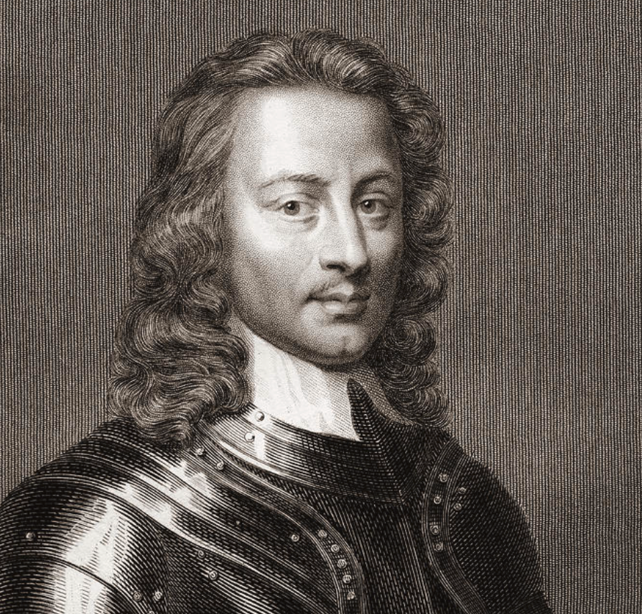
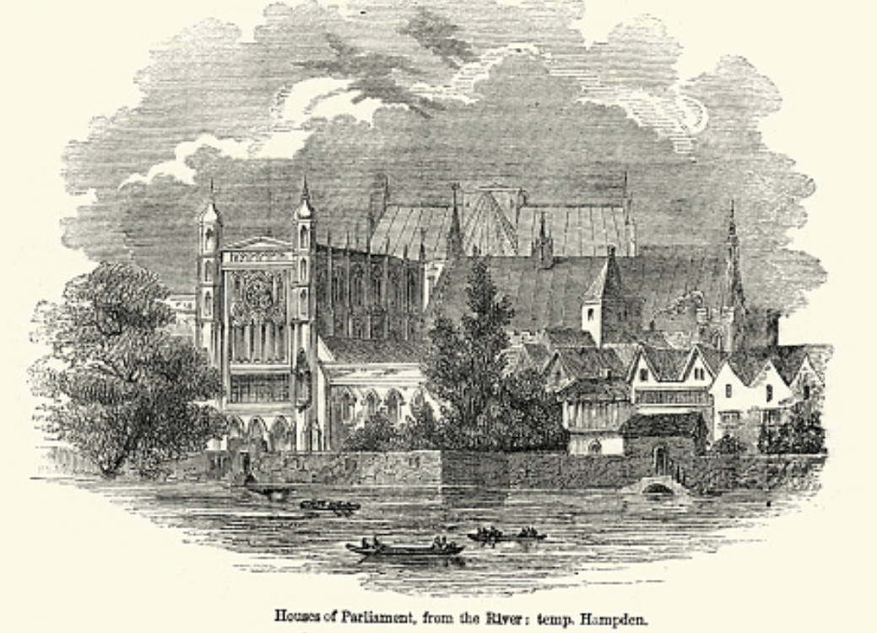
Review: Political Economy
From “Divine Right” and “Natural Order” to Enlightenment values…
Who was the first person to draft these words:?
“We hold these truths to be sacred & undeniable:
that all men are created equal & independant,
that from that equal creation they derive rights inherent & inalienable,
among which are the preservation of life, & liberty, & the pursuit of happiness;
that to secure these ends, governments are instituted among men, deriving their just powers from the consent of the governed…”
John Locke
Niccolo Machiavelli
Thomas Hobbes
Thomas Jefferson
George Washington
Why did he write them?

Slide 82
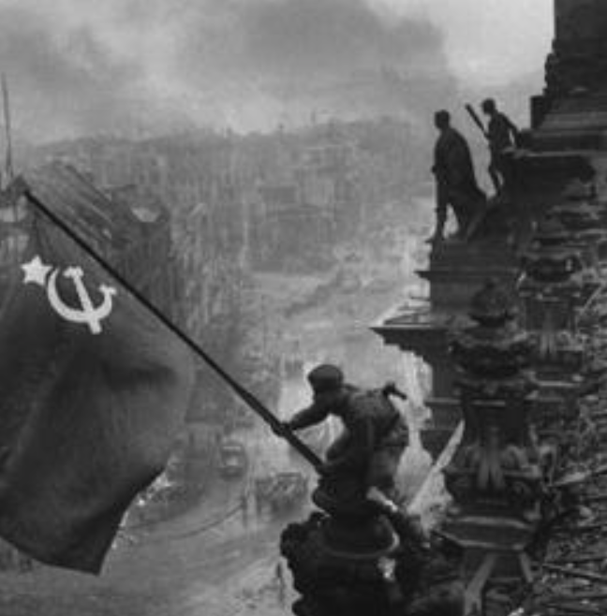
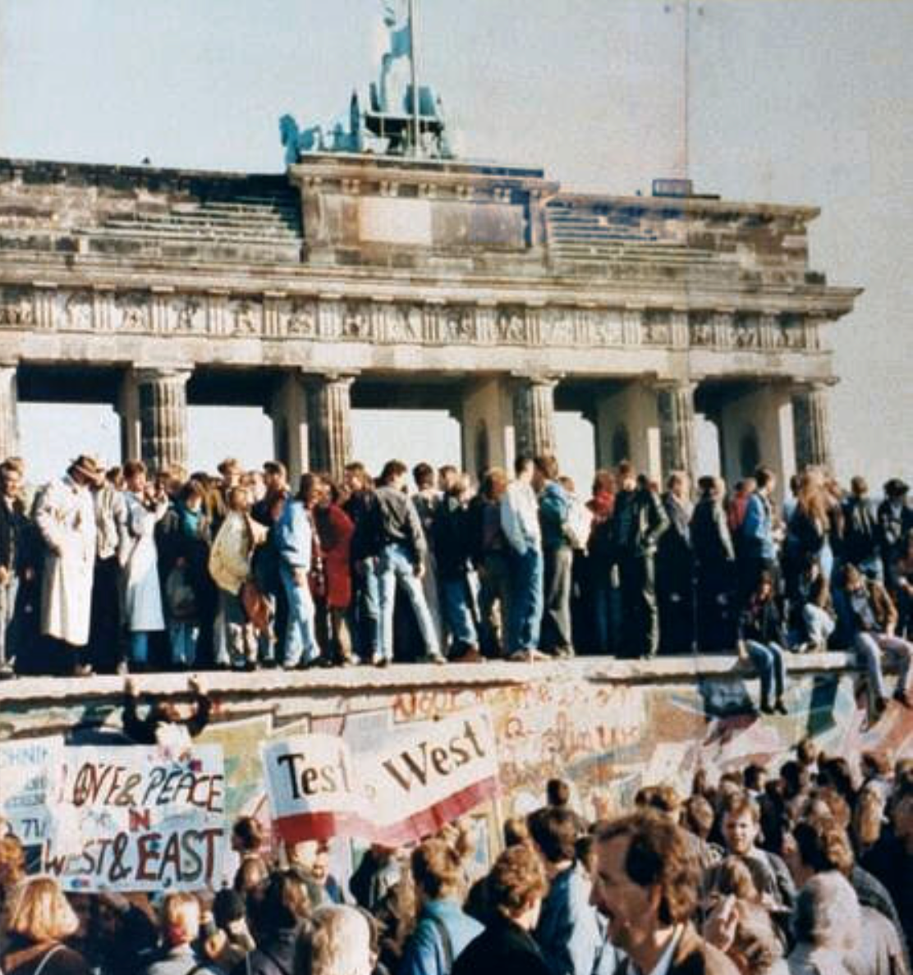
What Was the Proper Political Order?
Fears of “democracy” among American founders:
Madison: “Democracies have ever been spectacles of turbulence and contention... incompatible with personal security or the rights of property... as short in their lives as... violent in their deaths…”
Jefferson: “Gen’l Washington had not a firm confidence in the durability of our government… [& this] had some weight in his adoption of… ceremonies… calculated to prepare us gradually for a change which he believed possible…”
Hamilton: “the British government… best” as the only one “unit[ing] public strength with individual security…”
Adams: The American president should be announced as: “His Highness, the President of the United States, and Protector of the Rights of the Same…”
Question of political order thought settled: first in the rubble of Berlin in 1945, and then in the streets of East Germany in 1991:
Settled in favor of representative democracy, private property, & social insurance—late-1900s liberal democracy
But now reopened? Min Zhu (朱民) to me in 2015: “What are you Americans going to do to fix your broken political system?”

Slide 83
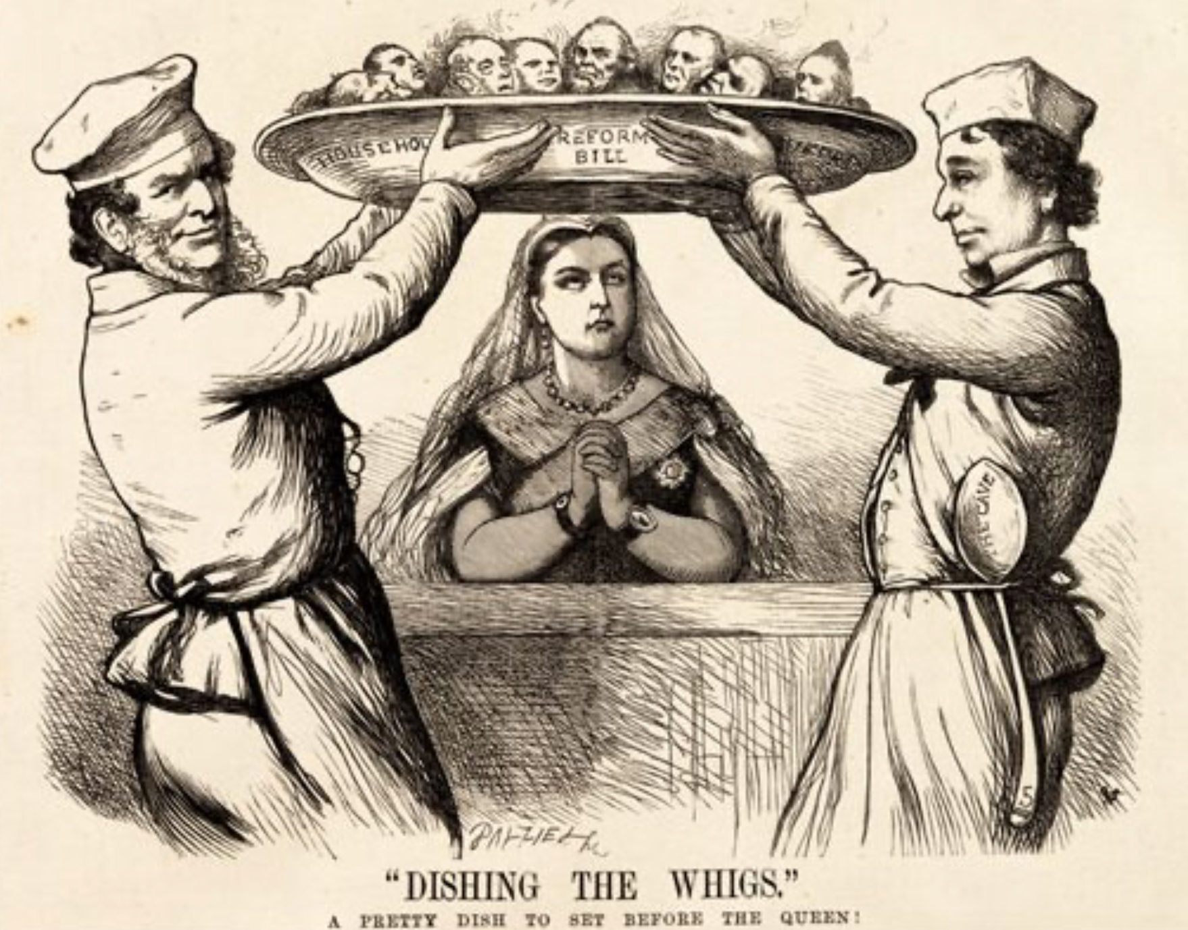
Franchise Restricted to the Rich Could Not Maintain Itself
The dynamic of franchise extension
Liberals in power would try extend on the principle that the new, poorer voters would be less conservative and would support them.
Threatening revolution would lead even conservatives to seek to extend the franchise in order to peel off of the revolutionary coalition those of the disenfranchised who had the most social power:
Earl Grey (yes, the tea): “The Principal… is to prevent… revolution…. I am reforming to preserve, not to overthrow…”
Charismatic leaders with popular followings would seek to give them votes, and then rule via plebiscites—going around the traditional elites
(Peculiar thing about Trump-Johnson: minority, and core is a minority of a minority…)
Conservatives: “dish the Whigs”—opportunities to form winning coalitions by appealing to those who were no profiting from the market economy, or felt that they were losing relative status in some ways…

Slide 84
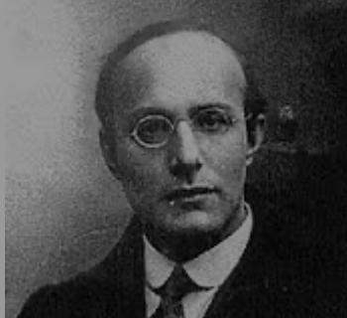
Popular Government and the Market Economy: Society’s Revenge
Karl Polanyi
People believe they have rights—to stable, supportive, nurturing communities; to incomes commensurate with their skills and status; and to money flows that will provide economic stability…
But a market society turns these things—land, labor, and finance—into commodities…
But they are not real commodities, they are fictitious commodities
And so you get your rights only if they satisfy a market profitability test
The only rights a market society respects are property rights:
& the only property rights that are worth anything are those that help you produce things for which rich people have a serious jones
Society will have its revenge: it will protect itself against the market logic, somehow, some way…

Slide 85
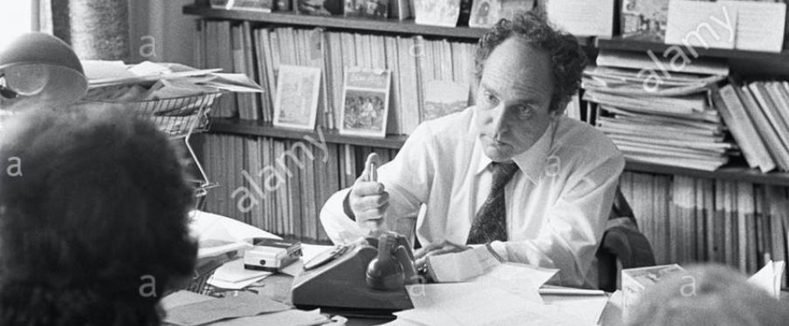
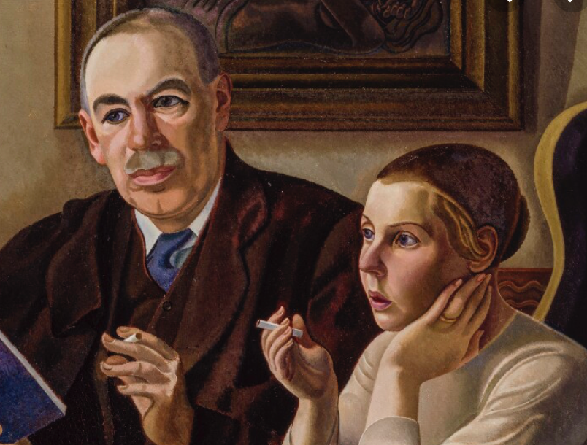

Digression: 5 Thinkers
Who shape my thought about the long 20th century—and how should, I think, shape yours
Beware! They are all deeply flawed…
But they are also geniuses, each in his way…
Beware of their followers! An iron law of ideology: a thinker’s most extravagant and aggressive followers will latch onto the stupidest and most shortsighted and wrong of their doctrines…
In historical order: Marx, Keynes, Hayek, Polanyi, Gellner
The other three thinkers:
Keynes: All that we need to produce general prosperity is technical adjustments to our system. Then the kingdom of freedom and prosperity will be within our grasp—and our major problems will no longer be economic ones
Gellner: The energy that most 19th century thinkers thought would go to “class“ went to “ethnos“ or “umma“ instead. The construction of ideological legitimations that makes sense both to dominants and to submissives who nevertheless believe they are part of some in-group is the key to understanding how societies stabilize themselves
Marx: Only the market economy will focus society’s energy on paying through the nose to boost the economy’s capital stock and to harvest the fruits of science and technology and then deploy them in production. But because the only demands in a market economy that matter are effective demands, the market economy also becomes a more “effective” means of slavery, for private property leads the proletariat to enslave themselves

Slide 86
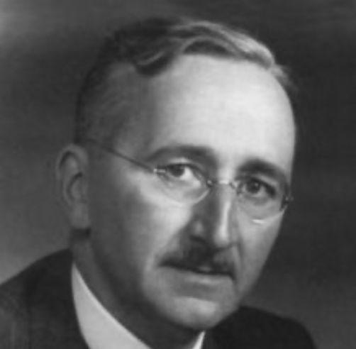
Hayek and Polanyi
Thumbnails on our first two:
Hayek:
Only the market economy can use society’s knowledge.
But the market economy cannot produce “social justice” and should not be asked to try—in fact, we need to recognize that all we can attain is freedom, and that will bring general prosperity, but that justice will be forever outside our reach
Polanyi:
The market economy turns land, labor, and finance into “fictitious commodities”
Society will have its revenge via a “double movement”

Slide 87
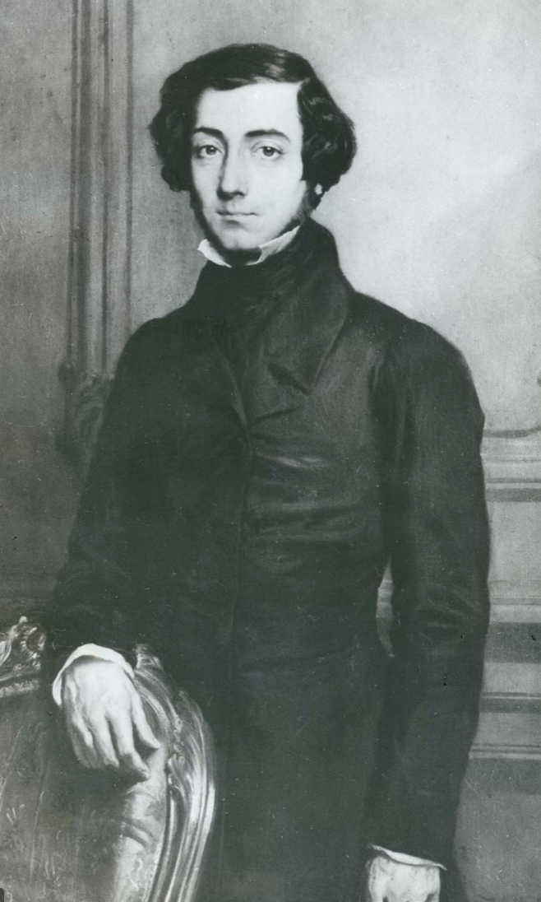
Plus Tocqueville
Toqueville on the rich as “elder brothers” in 1848:
“In the country all the landed proprietors, whatever their origin, antecedents, education or means, had come together, and seemed to form but one class: all former political hatred and rivalry of caste or fortune had disappeared from view. There was no more jealousy or pride displayed between the peasant and the squire, the nobleman and the commoner; instead, I found mutual confidence, reciprocal friendliness, and regard. Property had become, with all those who owned it, a sort of badge of fraternity. The wealthy were the elder, the less endowed the younger brothers; but all considered themselves members of one family, having the same interest in defending the common inheritance. As the French Revolution had infinitely increased the number of land-owners, the whole population seemed to belong to that vast family. I had never seen anything like it, nor had anyone in France within the memory of man…”
“The territorial aristocracy of past ages… [was] obliged… to come to the help of its servants and relieve their distress” no such reciprocal ties of obligation bound the aristocrats of manufactures to their workers: thus “the manufacturing aristocracy which we see rising before our eyes is one of the hardest that have appeared on the earth…”

Slide 88
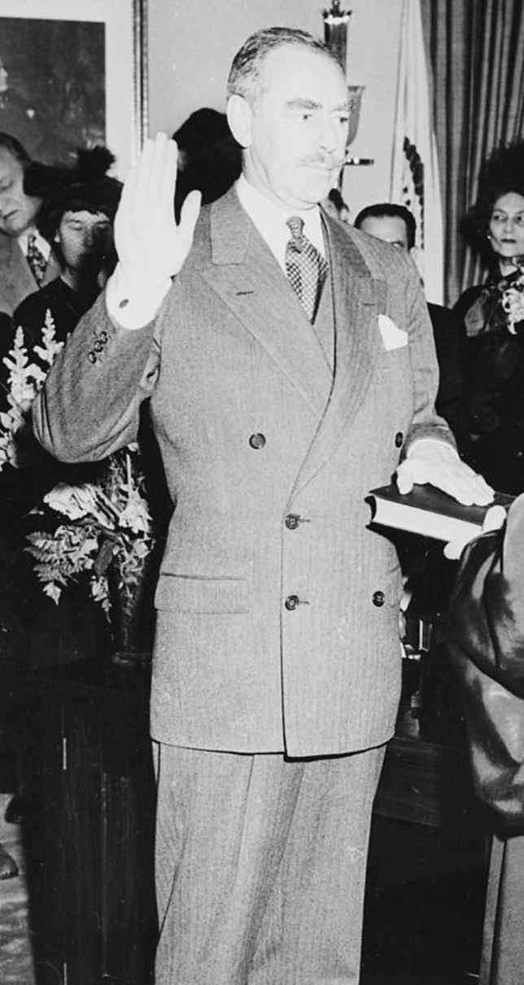
Plus Acheson
Dean Acheson, Secretary of State for Harry S Truman:
On the Republican Party as the party of wealth, enterprise, and opportunity:
“This business base of the Republican Party is stressed not in any spirit of criticism. The importance of business is an outstanding fact of American life. The achievements of business have been phenomenal. It is altogether appropriate that one of the major parties should represent its interests and its point of view…”
The subsequent transformation of the Republican Party from those who were going to become millionaires, or become even greater millionaires; to those who fear that they would lose it all…

Slide 89
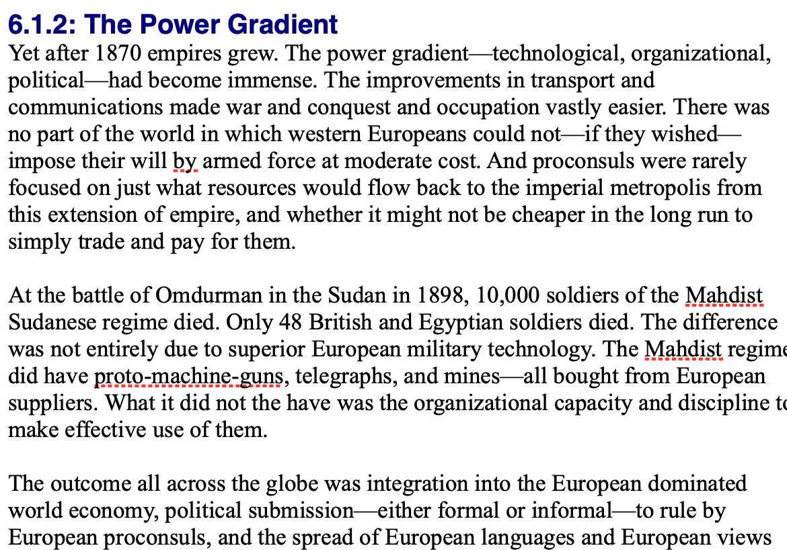
Review: Empire
By 1810 the tide of empire had been clearly ebbing…
But then things turned around: the power gradient:

Slide 90
To Your iClickers!
According to Eichengreen, graphing international capital flows and mobility since 1850 over time produces a graph that is:
V-shaped
U-shaped
W-shaped
An upward line
None of the above

Slide 91
To Your iClickers!
According to Eichengreen, the responsibilities of a pre-World War I central bank as steward of the global gold standard and also as lender-of-last-resort in domestic financial crises were:
in complete harmony
in irresolvable tension
for the most part manageable, before World War I at least, via fancy footwork and good luck
not understood
none of the above

Slide 92
To Your iClickers!
According to Eichengreen, the experience of being on the gold standard for North Atlantic economies in the 1870-1914 period was by and large a happy one, and the experience of countries at the world economy’s periphery was:
also by and large a happy one.
a mixed one.
a source of considerable tension, instability, and political upset.
once again, manageable with fancy footwork and a little good luck.
none of the above.

Slide 93
To Your iClickers!
In Eichengreen’s view, if World War I had somehow been avoided, would the global gold standard have remained stable in the 1920s and 1930s?
There are no guarantees, but probably yes.
There are no guarantees, but probably no.
Certainly not!
Certainly yes—unless several North Atlantic economies experienced a socialist revolution
None of the above.

Slide 94
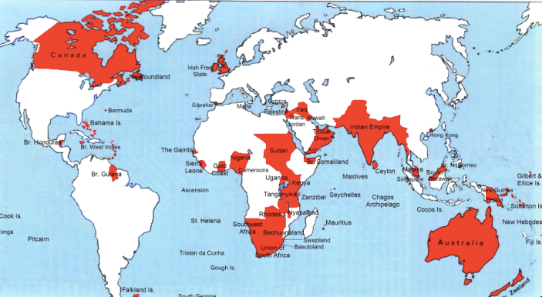
Empire

Slide 95
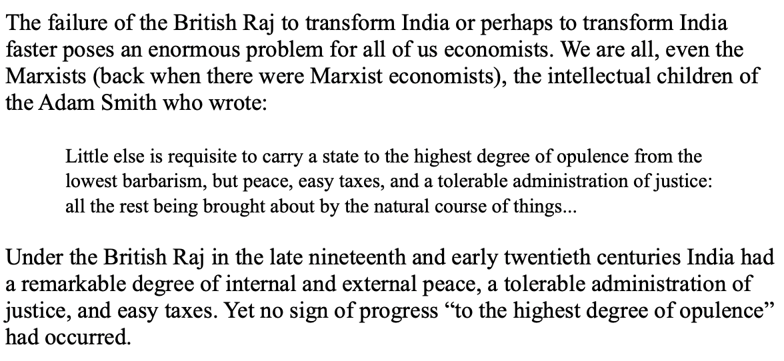
India
Why didn’t the British transform India into an industrial power?

Slide 96
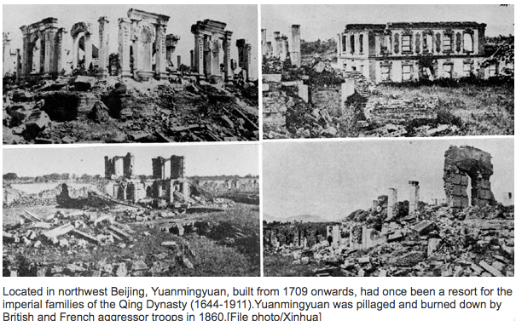
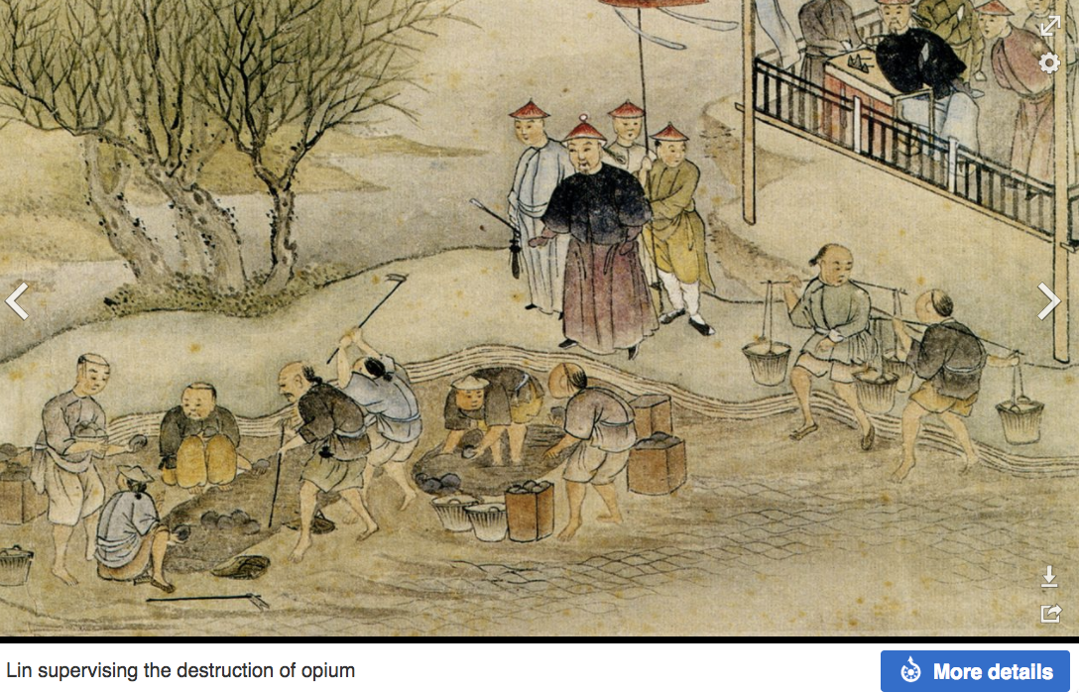
“Self-Strengthening”
The puzzle of China vs. Japan
Great Qing (大清)(1644-1912)
Wu Sangui (吳三桂)
The Rebellion of the Three Feudatories (三藩之亂)
Kangxi and Qianlong: “revere the emperor and expel the barbarians” is difficult to pursue when the emperor and his clan identify themselves as “barbarians”
Tai-Ping Rebellion (太平天國運動)
Cixi ( 慈禧太后)
Li Hongzhang (李鴻章)the Kai-Ping coal mine, Chang Yen-Mao, and Herbert Hoover

Slide 97
Formal Empires
There were, broadly, three views as to why European late-1800s empires rose to such domination, each of which with its own view of what was to be done to fix the situation:
One view is that of John Hobson: The major economic problem was the business cycle. Equipping the military needed to maintain the empire puts people to work. And an empire is a good source of consumers for the products of domestic factories. European governments that pursued empire, Hobson thought, were less likely to face economic distress and so more likely to continue in office.
A second view was that of Joseph Schumpeter: imperialism as the last gasp of military status aristocracy.
The third view was that empires were ordained by God—or at least morally required or desirable, for European powers had a civilizing mission. The Europeans were lucky enough to be the grownups, and it was the obligation of the grownups to civilize the world. But perhaps civilization is best spread by newspapers and books and merchants and engineers, rather than by alien proconsuls? Just a thought.

Slide 98
Informal Empires
But even where Britain (or France, or Germany, or Portugal, or Spain, or those who thought of themselves as descended from the conquistadores of Castile, or Anglo-Saxon settlers) did not rule, they reigned:
Britain seemed successful: playing by Britain’s rules seemed wise…
Britain was powerful: playing by Britain’s rules seemed likely to keep it from getting annoyed…
Britain was working very hard to make itself attractive—to make becoming a Briton-by-proxy of some sort straightforward and profitable in both money and cultural terms…
Britain was the first-mover hegemon: international cooperation was on its terms…

Slide 99
Catch Our Breath…
Comments?
Questions?

Slide 100
Review: Revolutions
“Petty Officer Lemmgen… arrived at the Ministry [of War]… found… Lieutenant HambuRger.... Lemmgen produced a typed document with the following text: ‘Comrades and Workers! The Ebert-Scheidemann government have made themselves impossible.... The undersigned Revolutionary Council has provisionally assumed power.’
“Lieutenant Hamburger inspected the document and became properly indignant. ‘But where are the signatures? Before I can comply with this order, you’ll have to go back and get it properly signed. Otherwise any little shorthand typist could declare the government deposed.’ Petty Officer Lemmgen... saw the logic…. So he and his men saluted... and made their way back to the Revolutionary Council to obtain the necessary signatures....
“But by the time he had obtained the signatures, Lemmgen had learned that the People’s Naval Division had declared itself neutral. So he did not return to the Ministry of War…”

Slide 101
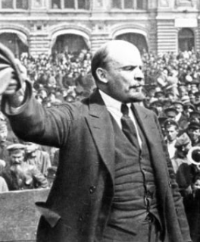
Lenin
A quick power grab…
Confidently expecting a German revolution, and then massive aid…
Brutal civil war
Kerenskyites
Reds
Whites
Nationalists
What was the revolutionary government to do?
Ludendorff’s German war economy…

Slide 102
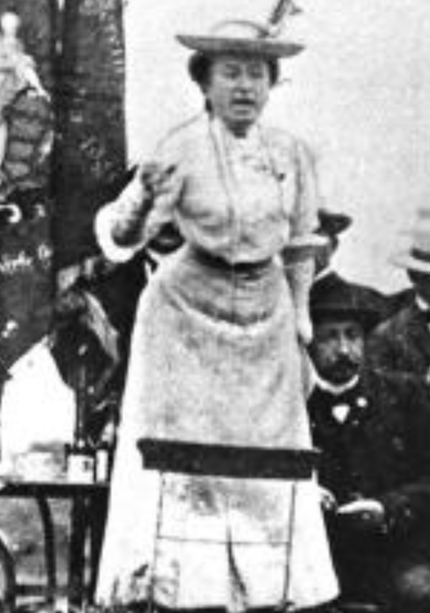
Red Rosa on Lenin
“Without general elections, without unrestricted freedom of press and assembly, without a free struggle of opinion, life dies out in every public institution…. Only the bureaucracy remains…. A few dozen party leaders of inexhaustible energy and boundless experience direct and rule….
“An elite of the working class is invited from time to time to meetings where they are to applaud the speeches of the leaders, and to approve proposed resolutions unanimously–at bottom, then, a clique affair…. Such conditions must inevitably cause a brutalization of public life: attempted assassinations, shooting of hostages, etc…
“Freedom only for the supporters of the government, only for the members of one party–however numerous they may be–is no freedom at all. Freedom is always and exclusively freedom for the one who thinks differently. Not because of any fanatical concept of “justice” but because all that is instructive, wholesome and purifying in political freedom depends on this essential characteristic, and its effectiveness vanishes when ‘freedom’ becomes a special privilege…

Slide 103
Digression: How to Study
Will I ask you about Jan Christian Smuts? About the prayer (and theology) of the Grigua?
No…
Themes and concepts…
But you need narratives and stories to hang onto them…
And our brains are very good at deep-sixing useless information
Andy Matuschak: Why Books Don’t Work <https://andymatuschak.org/books/>:
“Picture some serious non-fiction tomes. The Selfish Gene; Thinking, Fast and Slow; Guns, Germs, and Steel; etc.
“Have you ever had a book like this—one you’d read—come up in conversation, only to discover that you’d absorbed what amounts to a few sentences? I’ll be honest: it happens to me regularly. Often things go well at first. I’ll feel I can sketch the basic claims, paint the surface; but when someone asks a basic probing question, the edifice instantly collapses. Sometimes it’s a memory issue: I simply can’t recall the relevant details. But just as often, as I grasp about, I’ll realize I had never really understood the idea in question, though I’d certainly thought I understood when I read the book. Indeed, I’ll realize that I had barely noticed how little I’d absorbed until that very moment. I know I’m not alone here…

Slide 104
Skipped Topic: Pre-1914 Political Economy: Over in Europe
The June Days of 1848 in Paris:
Tocqueville:
“The insurrection of June [1848]... class against class... a blind and rude, but powerful, effort on the part of the workmen to escape from the necessities of their condition, which had been depicted to them as one of unlawful oppression…. The closing of the national workshops… occasioned the rising…”
“Thousands… hastening to our aid from every part of France.... Thanks to the railroads, some had already come from fifty leagues’ distance... every class of society... peasants... shopkeepers... landlords and nobles all mingled together... they rushed into Paris with unequalled ardour: a spectacle as strange and unprecedented in our revolutionary annals.... The insurgents received no reinforcements, whereas we had all France for reserves…”

Slide 105
French Politics
Régimes stability is not on the menu:
the terrorist dictatorship of the Jacobins (the mainspring of popular government… amid revolution it is at once virtue and terror: virtue, without which terror is fatal; terror, without which virtue is impotent…)
a corrupt and gerrymandered 5-man executive of the Directory, defended on October 5, 1795 by the “whiff of grapeshot” of Napoleon Bonaparte and Joachim Murat, that managed to generate the first modern hyperinflation, defended itself against a royalist coup plotted by two of its five members (Barthelemy and Carnot) and its most successful general (Pichegru), and was then overthrown by the same Napoleon in 1799.
a dictatorship, with Napoleon Bonaparte as “First Consul”, until 1804.
an empire, with Napoleon Bonaparte as Emperor of the French, until suppressed by the other European powers in 1815.
a restored Bourbon monarchy, with first Louis XVIII and then Charles X, until 1830.
an alternative Orleanist monarchy, with King Louis-Philippes as the king-citizen, overthrown in 1848.
a second republic, overthrown by its own president, Napoleon’s nephew Louis Napoleon, which collapsed under pressure of military defeat in 1870.
a socialist commune, in Paris at least.
a third republic, which suppressed the commune—but promptly chose a royalist Marshal MacMahon, as president.
a failed attempt by third republic president Marshal MacMahon to replace himself by a King Henry V.
a failed attempt by the ex-Minister of War Georges Boulanger to seize power for his RRR movement: Revanche, Révision, Restauration (revenge on Germany, revision of the constitution, restoration of the monarchy).

Slide 106
Left-Wing Normal European Politics I
Disjunction between policies and rhetoric:
The Socialist Party of Germany’s Erfurt and Gotha programs seek things like: holidays for elections, two-year legislative terms, the right to bear arms, equal rights for women, the prohibition of spending public funds for religious purposes, free public schools and colleges, free medical care including midwifery, an eight-hour working day, no child labor under 14, a 36-hour minimum weekend, an occupational safety and health administration…

Slide 107
Left-Wing Normal European Politics II
Disjunction between policies and rhetoric:
But also: “By every lawful means to bring about a free state and a socialistic society, to effect the destruction of the iron law of wages by doing away with the system of wage labor.” And they sought: “the transformation of the capitalist private ownership of the means of production—land and soil, pits and mines, raw materials, tools, machines, means of transportation—into social property and the transformation of the production of goods into socialist production carried on by and for society.” And they believed: “This… emancipation… of the entire human race…. But it can only be the work of the working class, because all other classes… have as their common goal the preservation of the foundations of contemporary society.”

Slide 108
Center and Right-Wing Normal European Politics
The touchstone was “fairness”: it was not fair that those who did not work hard and did not play by the rules got lots of good things:
Those who did not play by the rules could be on either end of the wealth-and-power spectrum:
Parasitic aristocrats and cruel plutocrats
Those poor who wanted something for nothing, or got above their station
A middle-class, social order movement
Focus voters’ attention on the disruptive utopian aspirations of the left, and electoral coalitions could be preserved…
Preserve as much as possible of old orders of hierarchy in changing times:
Reform to preserve; change so things could stay the same
Find new reasons why hierarchy is good: social darwinism

Slide 109
Magnifying Non-Economic Cleavages Had Dangers
Society under threat not by economic inequality but by social disorder—or aliens—or other nations. Plus:
A right-wing landed and bureaucratic upper class that had, by and large, lost its social role.
A belief by politicians anxious to paper over class divisions that they could be papered over with national or ethnic unity.
A growing social-darwinist current that struggle was good, and the victors should be rewarded
Even or especially military struggle by peoples-in-arms, over not what language a province would be administered in but who would live there
These stored up trouble as 1914 approached.
In 1919 John Maynard Keynes was to write, bitterly, that he, his peers, and his elders had regarded:
“the projects and politics of militarism and imperialism, of racial and cultural rivalries, of monopolies, restrictions, and exclusion, which were to play the serpent to this paradise… [as] little more than the amusements of his daily newspaper…”

Slide 110
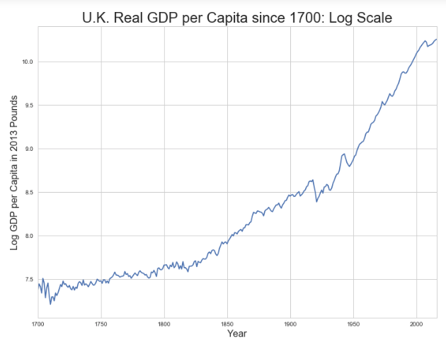
Skipped Topic: Passing the Baton: From Britain to America
The Industrial Revolution took place in Britain
The standard explanation four or five largely independent strands coming together.:
Limited government, security of property, and freedom of contract
Science and the technological tradition of sustained inquiry
Victory in the wars of the Commercial Revolution era
Machinery making, "tinkering", and "gadgets"—primarily made out of metal.
Coal in Britain—the only thing that made a steam engine potentially profitable.
Plus high elasticity of demand for leading-sector products…
http://bradford-delong.com brad.delong@gmail.com

Slide 111
iClickers: Why Breaktrhrough?
The principal reason that the Industrial Revolution took place in late eighteenth century Britain (rather than in Sung China, or Abbasid Baghdad, or Antonine Dynasty Rome, or during the Hellenistic Age) is:
A lack of human numbers thinking about problems of production
A lack of good means of communication—e.g. printing—for diffusing information about how to solve problems of production
A lack of experience using coal as an energy source
A lack of the incentive created by high real wages leading to a strong desire to make labor more productive
None of the above/not enough information
http://bradford-delong.com brad.delong@gmail.com

Slide 112
iClicker: Why Passing the Baton
The principal reason that the twentieth century was an American rather than a second British century was:
The United States’s aggressive and enthusiastic welcome of immigrants
The United States’s focus on broad-based technical education
The United States’s extraordinary abundance of natural resources driving high real wages and enormous incentives to build machines to manipulate matter
A U.S. government that took industrial development as a key policy goal, rather than being comfortable with laissez-faire
None of the above/not enough information
http://bradford-delong.com brad.delong@gmail.com

Slide 113
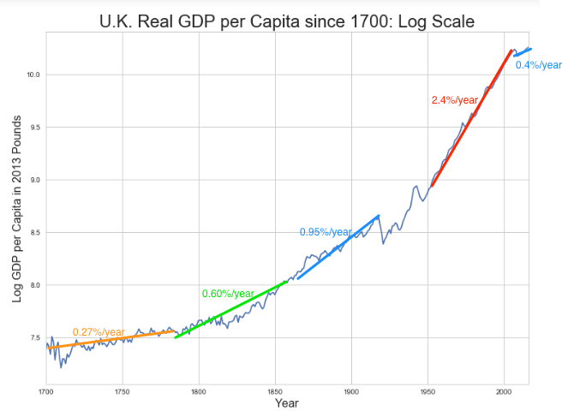
British Productivity Growth Acceleration
http://bradford-delong.com brad.delong@gmail.com

Slide 114
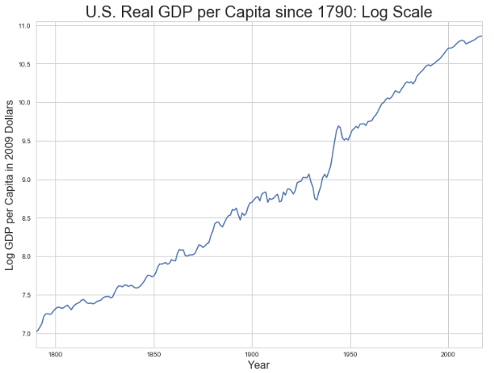
But Even in the First Half of the Nineteenth Century the U.S. Was Outpacing Britain in Growth…
Even in the first half of the nineteenth century—the period in which the British Industrial Revolution made it the wonder of the world—economic growth in the United States was proceeding faster than in Britain.
While British real GDP per capita was increasing at less than 0.6 percent per year
American was growing at a hair over one percent per year.
And a significantly larger share of GDP was going to the white working class in the United States, in the north at least:
The extraordinary abundance of land and the possibility of "lighting out for the territory", in the words of American author Mark Twain, gave even workers without property or notably scarce skills substantial economic bargaining power.
http://bradford-delong.com brad.delong@gmail.com

Slide 115
And Starting in the Late Nineteenth Century
Second Industrial Revolution…
Why the U.S. and Germany, and not Britain?
Immigration and Population
Was resource scarcity no longer a factor?
Was the differential in the growth rate h of the stock of useful economic knowledge even greater than the differential in the growth rate g of the efficiency-of-labor?
http://bradford-delong.com brad.delong@gmail.com

Slide 116
Phases of American Growth
1.0% per year in GDP per capita from 1760-1860: resource abundance
1.6% per year in GDP per capita from 1860-1929:
“Great traverse”: K/Y ratio up from 2.5 to 4
Half of it an increase in savings rates
Half of it a fall in the price of capital goods
2.5% per year in GDP per capita from 1929-1973
“Fordism”
Expected further acceleration: it did not happen
Post-1973
Productivity slowdown 1973-1995 (environment, oil, baby boom, feminism)
“New economy” 1995-2006
Post-2006 collapse of growth
http://bradford-delong.com brad.delong@gmail.com

Slide 117
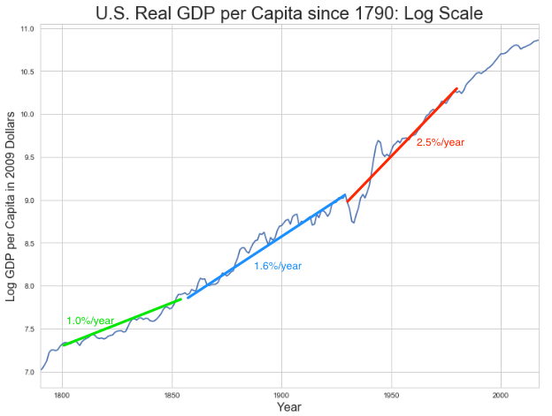
American Productivity Growth Acceleration
http://bradford-delong.com brad.delong@gmail.com

Slide 118
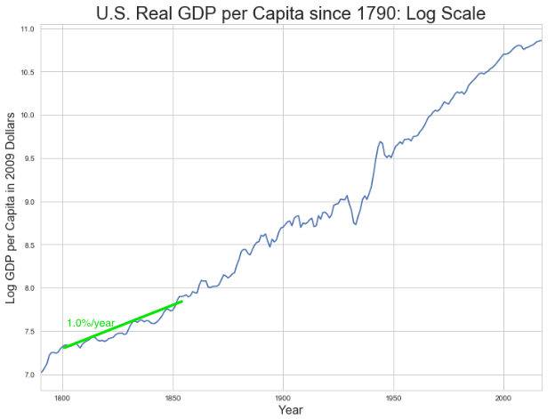
Early Nineteenth Century: Westward Expansion
Westward expansion
The “American System”
Abundant natural resources
Very high real wages
Focus on raising labor productivity
Hence fast efficiency-of-labor growth
Britain, by contrast, focused on economizing on (non-coal) raw materials
http://bradford-delong.com brad.delong@gmail.com

Slide 119
The Importance of Resources 1760-1860
Major westward expansion and "Amerindian removal”
The century 1760 to 1860 before the Civil War.
We have U.S. output-per-worker growth then at about 1.0% per year…
…in contrast to British output-per-worker growth at about 0.5% per year.
We have the U.S. population and labor force growing at 2.5% per year…
…from 2.5 to 30 million.
http://bradford-delong.com brad.delong@gmail.com

Slide 120
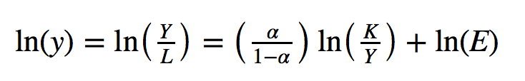
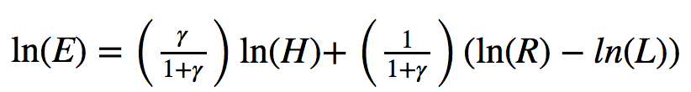
The Importance of Resources 1760-1860
Recall our basic Solow Model:
http://bradford-delong.com brad.delong@gmail.com

Slide 121
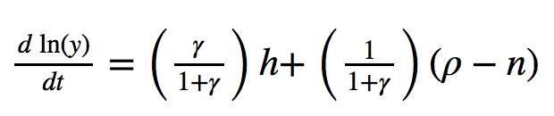
The Importance of Resources 1760-1860
Recall our basic Solow Model:
Assume K/Y constant, so the growth rate g of the efficiency of labor and the growth rate of output-per-worker are the same:
http://bradford-delong.com brad.delong@gmail.com

Slide 122
The Importance of Resources 1760-1860
Recall our basic Solow Model:
Assume K/Y constant, so the growth rate g of the efficiency of labor and the growth rate of output-per-worker are the same:
http://bradford-delong.com brad.delong@gmail.com

Slide 123
The Importance of Resources 1760-1860
Recall our basic Solow Model:
Assume K/Y constant, so the growth rate g of the efficiency of labor and the growth rate of output-per-worker are the same:
Let’s, last, fit this to history in the century before the 1860 election of President Abraham Lincoln and the ensuing American Civil War:
http://bradford-delong.com brad.delong@gmail.com

Slide 124

The Importance of Resources 1760-1860
Recall our basic Solow Model:
Assume K/Y constant, so the growth rate g of the efficiency of labor and the growth rate of output-per-worker are the same:
Let’s, last, fit this to history in the century before the 1860 election of President Abraham Lincoln and the ensuing American Civil War:
http://bradford-delong.com brad.delong@gmail.com

Slide 125

Westward Expansion
http://bradford-delong.com brad.delong@gmail.com

Slide 126

The Importance of Resources 1760-1860
We have two parameters left: γ and h, the weight of ideas in efficiency-of-labor growth and the rate of growth of the stock of useful ideas for the economy in American heads, respectively:
http://bradford-delong.com brad.delong@gmail.com

Slide 127

The Importance of Resources 1760-1860
We have two parameters left: γ and h, the weight of ideas in efficiency-of-labor growth and the rate of growth of the stock of useful ideas for the economy in American heads, respectively:
http://bradford-delong.com brad.delong@gmail.com

Slide 128
The Importance of Resources 1760-1860
Thus if γ→∞ then h→0.010
http://bradford-delong.com brad.delong@gmail.com

Slide 129
The Importance of Resources 1760-1860
Thus if γ→∞ then h=0.010
Thus if γ=3.0 then h=0.00667
http://bradford-delong.com brad.delong@gmail.com

Slide 130
The Importance of Resources 1760-1860
Thus if γ→∞ then h=0.010
Thus if γ=3.0 then h=0.00667
Thus if γ=1.0 then h=0.00
http://bradford-delong.com brad.delong@gmail.com

Slide 131
The Importance of Resources 1760-1860
Thus if γ→∞ then h=0.010
Thus if γ=3.0 then h=0.00667
Thus if γ=1.0 then h=0.00
Looking across the Atlantic Ocean to Great Britain, we see that over there it is indeed the case that h=0.005 from 1760 to 1860. Faster growth of h in America due to some catchup with the world's first and leading industrial nation seems likely. So γ=3.0 has some claim to be the most likely value…
http://bradford-delong.com brad.delong@gmail.com

Slide 132
A Counterfactual
The Royal Proclamation of October 1763:
Our Royal Will and Pleasure… no... Governor or Commander in Chief in... our... Colonies or Plantations in America do... grant Warrants of Survey, or pass Patents for any Lands beyond the Heads or Sources of any of the Rivers which fall into the Atlantic Ocean from the West and North West, or upon any Lands whatever, which, not having been ceded to or purchased by Us as aforesaid, are reserved to the said Indians, or any of them...
http://bradford-delong.com brad.delong@gmail.com

Slide 133

What If This Royal Proclamation Had Stuck?
What if ρ=0?
If γ → ∞ and h=0.010 then g=0.01
If γ=3.0 and h=0.00667 then g=−0.00125
If γ=1.5 and h=0.000 then g=−0.01
http://bradford-delong.com brad.delong@gmail.com

Slide 134
What If This Royal Proclamation Had Stuck?
What if ρ=0?
If γ → ∞ and h=0.010 then g=0.01
If γ=3.0 and h=0.00667 then g=−0.00125
If γ=1.5 and h=0.000 then g=−0.01
An America penned behind the Appalachians would probably have seen its living standards and productivity levels not growing at 1% per year from 1760 to 1860 but shrinking.
For γ=3.0, living standards and productivity levels would have shrunk at a pace of -0.125% per year
http://bradford-delong.com brad.delong@gmail.com

Slide 135
What If This Royal Proclamation Had Stuck?
What if ρ=0?
Of course, a poorer America would probably have seen fewer immigrants.
But it might not have seen that many fewer immigrants.
It would no longer have been quite as attractive to move from Britain to America over 1760 to 1860.
But it still would have been very attractive to move from France, Germany, Scotland—or most of all from Potato Blight-ridden Ireland...
In what other ways might this counterfactual alternate-history "little America" would likely have been different in 1860 than America actually was?
http://bradford-delong.com brad.delong@gmail.com

Slide 136

“Trail of Tears’
http://bradford-delong.com brad.delong@gmail.com

Slide 137
A large chunk of America's pre-1860 visible growing prosperity was based not just on African-American slavery, but also on "Amerindian removal"
http://bradford-delong.com brad.delong@gmail.com

Slide 138
Catch Our Breath…
Ask me two questions…
Make two comments…

Slide 139

Late Nineteenth-Early Twentieth Century: “Great Traverse”
Invention of the industrial research lab
First globalization
Technologies of Second Industrial Revolution
Economies of scale and mass production
Falling price of capital goods
Greater savings effort
Plus mass immigration
Rapidly rising inequality
Or was it? Emancipation…
http://bradford-delong.com brad.delong@gmail.com

Slide 140
Capital Deepening
Lowered deprecation rate δ
From 5% to 3% per year
http://bradford-delong.com brad.delong@gmail.com

Slide 141
Capital Deepening
Lowered deprecation rate δ
From 5% to 3% per year
Increased savings rate s
Capital-output ratio goes from 2.5 to 4 across 70 years
http://bradford-delong.com brad.delong@gmail.com

Slide 142
Capital Deepening
Lowered deprecation rate δ
From 5% to 3% per year
Increased savings rate s
Capital-output ratio goes from 2.5 to 4 across 70 years
with an α=1, output-per-worker proportional to the capital-output ratio
ln(4/2.5)/70 = 0.007
g = 0.9%/year
http://bradford-delong.com brad.delong@gmail.com

Slide 143
Capital Deepening
Capital-output ratio goes from 2.5 to 4 across 70 years
with an α=1, output-per-worker proportional to the capital-output ratio
ln(4/2.5)/70 = 0.007
g = 0.9%/year
Second Industrial Revolution
Large managerial corporation
Large-scale investment banking
Industrial research lab
Continent-wide market
Globalization
http://bradford-delong.com brad.delong@gmail.com

Slide 144

Mid Twentieth Century: Drive to High Mass Consumption
DARPA, etc.: two heads are better than one
“Fordist” oligopolies
Second globalization
Keynesian stabilization policies
Falling and then low inequality
For white guys…
http://bradford-delong.com brad.delong@gmail.com

Slide 145
Mid Twentieth Century: Drive to High Mass Consumption
DARPA, etc.: two heads are better than one
“Fordist” oligopolies
Second globalization
Keynesian stabilization policies
Falling and then low inequality
For white guys…
http://bradford-delong.com brad.delong@gmail.com

Slide 146
Catch Our Breath…
Ask me two questions…
Make two comments…

Slide 147
Notes
Lecture- Revolution #TCEH (22) 2017-02-26.key

